Slide 1
Results and New Insights from Vertical Testing of LCLS-II Production Cavities
Dan Gonnella
For the LCLS-II Project

Slide 2
Outline
Overview of LCLS-II Cavity Requirements
First Article Results
Change of Recipe
R_{BCS} in Production Cavities
Production Results
Conclusions and Outlook

Slide 3
Outline
Overview of LCLS-II Cavity Requirements
First Article Results
Change of Recipe
R_{BCS} in Production Cavities
Production Results
Conclusions and Outlook

Slide 4
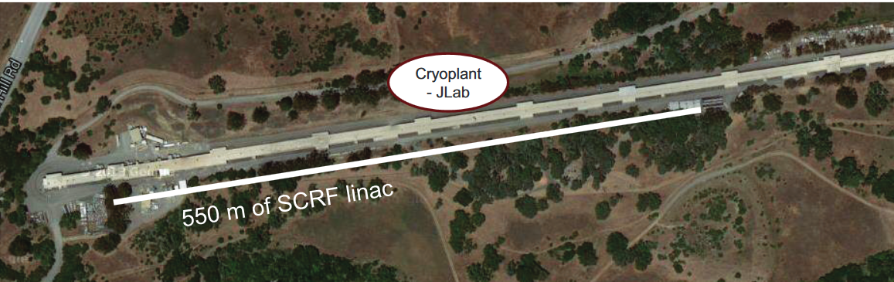
Introduction to LCLS-II
The SRF linac is closely based on the XFEL/ILC/TESLA Design
It consists of 35 cryomodules each with 8 cavities – total of 280 cavities
The 280 1.3 GHz 9-cell cavities have a very ambitious Q specification:
Additionally, cavities must reach 19 MV/m
2.7 x 10¹⁰ at 16 MV/m and 2 K
2.5 x 10¹⁰ at 16 MV/m and 2 K
Q specification lowered in VT due to addition of stainless steel blank on short side of cavity – adds ~0.8 nΩ of R_{res}

Slide 5
Cavity Preparation
In order to achieve the ambitious Q specification, all 9-cell cavities for LCLS-II are prepared with nitrogen-doping
Original recipe:
140 μm bulk EP
800ºC degas for 3 hours in vacuum
2 minutes at 800ºC in 20-30 mTorr of N₂
6 minutes at 800ºC in vacuum
5-7 μm light EP

Slide 6
Cavity Preparation
In order to achieve the ambitious Q specification, all 9-cell cavities for LCLS-II are prepared with nitrogen-doping
Original recipe:
140 μm bulk EP
800ºC degas for 3 hours in vacuum
2 minutes at 800ºC in 20-30 mTorr of N₂
6 minutes at 800ºC in vacuum
5-7 μm light EP

Slide 7
Cavity Preparation
In order to achieve the ambitious Q specification, all 9-cell cavities for LCLS-II are prepared with nitrogen-doping
Original recipe:
140 μm bulk EP
800ºC degas for 3 hours in vacuum
2 minutes at 800ºC in 20-30 mTorr of N₂
6 minutes at 800ºC in vacuum
5-7 μm light EP
Cavities are being produced by Research Instruments GmbH (RI) and Ettore Zanon S.p.a (EZ)
Niobium was procured from Tokyo Denkai and OTIC Ningxia

Slide 8
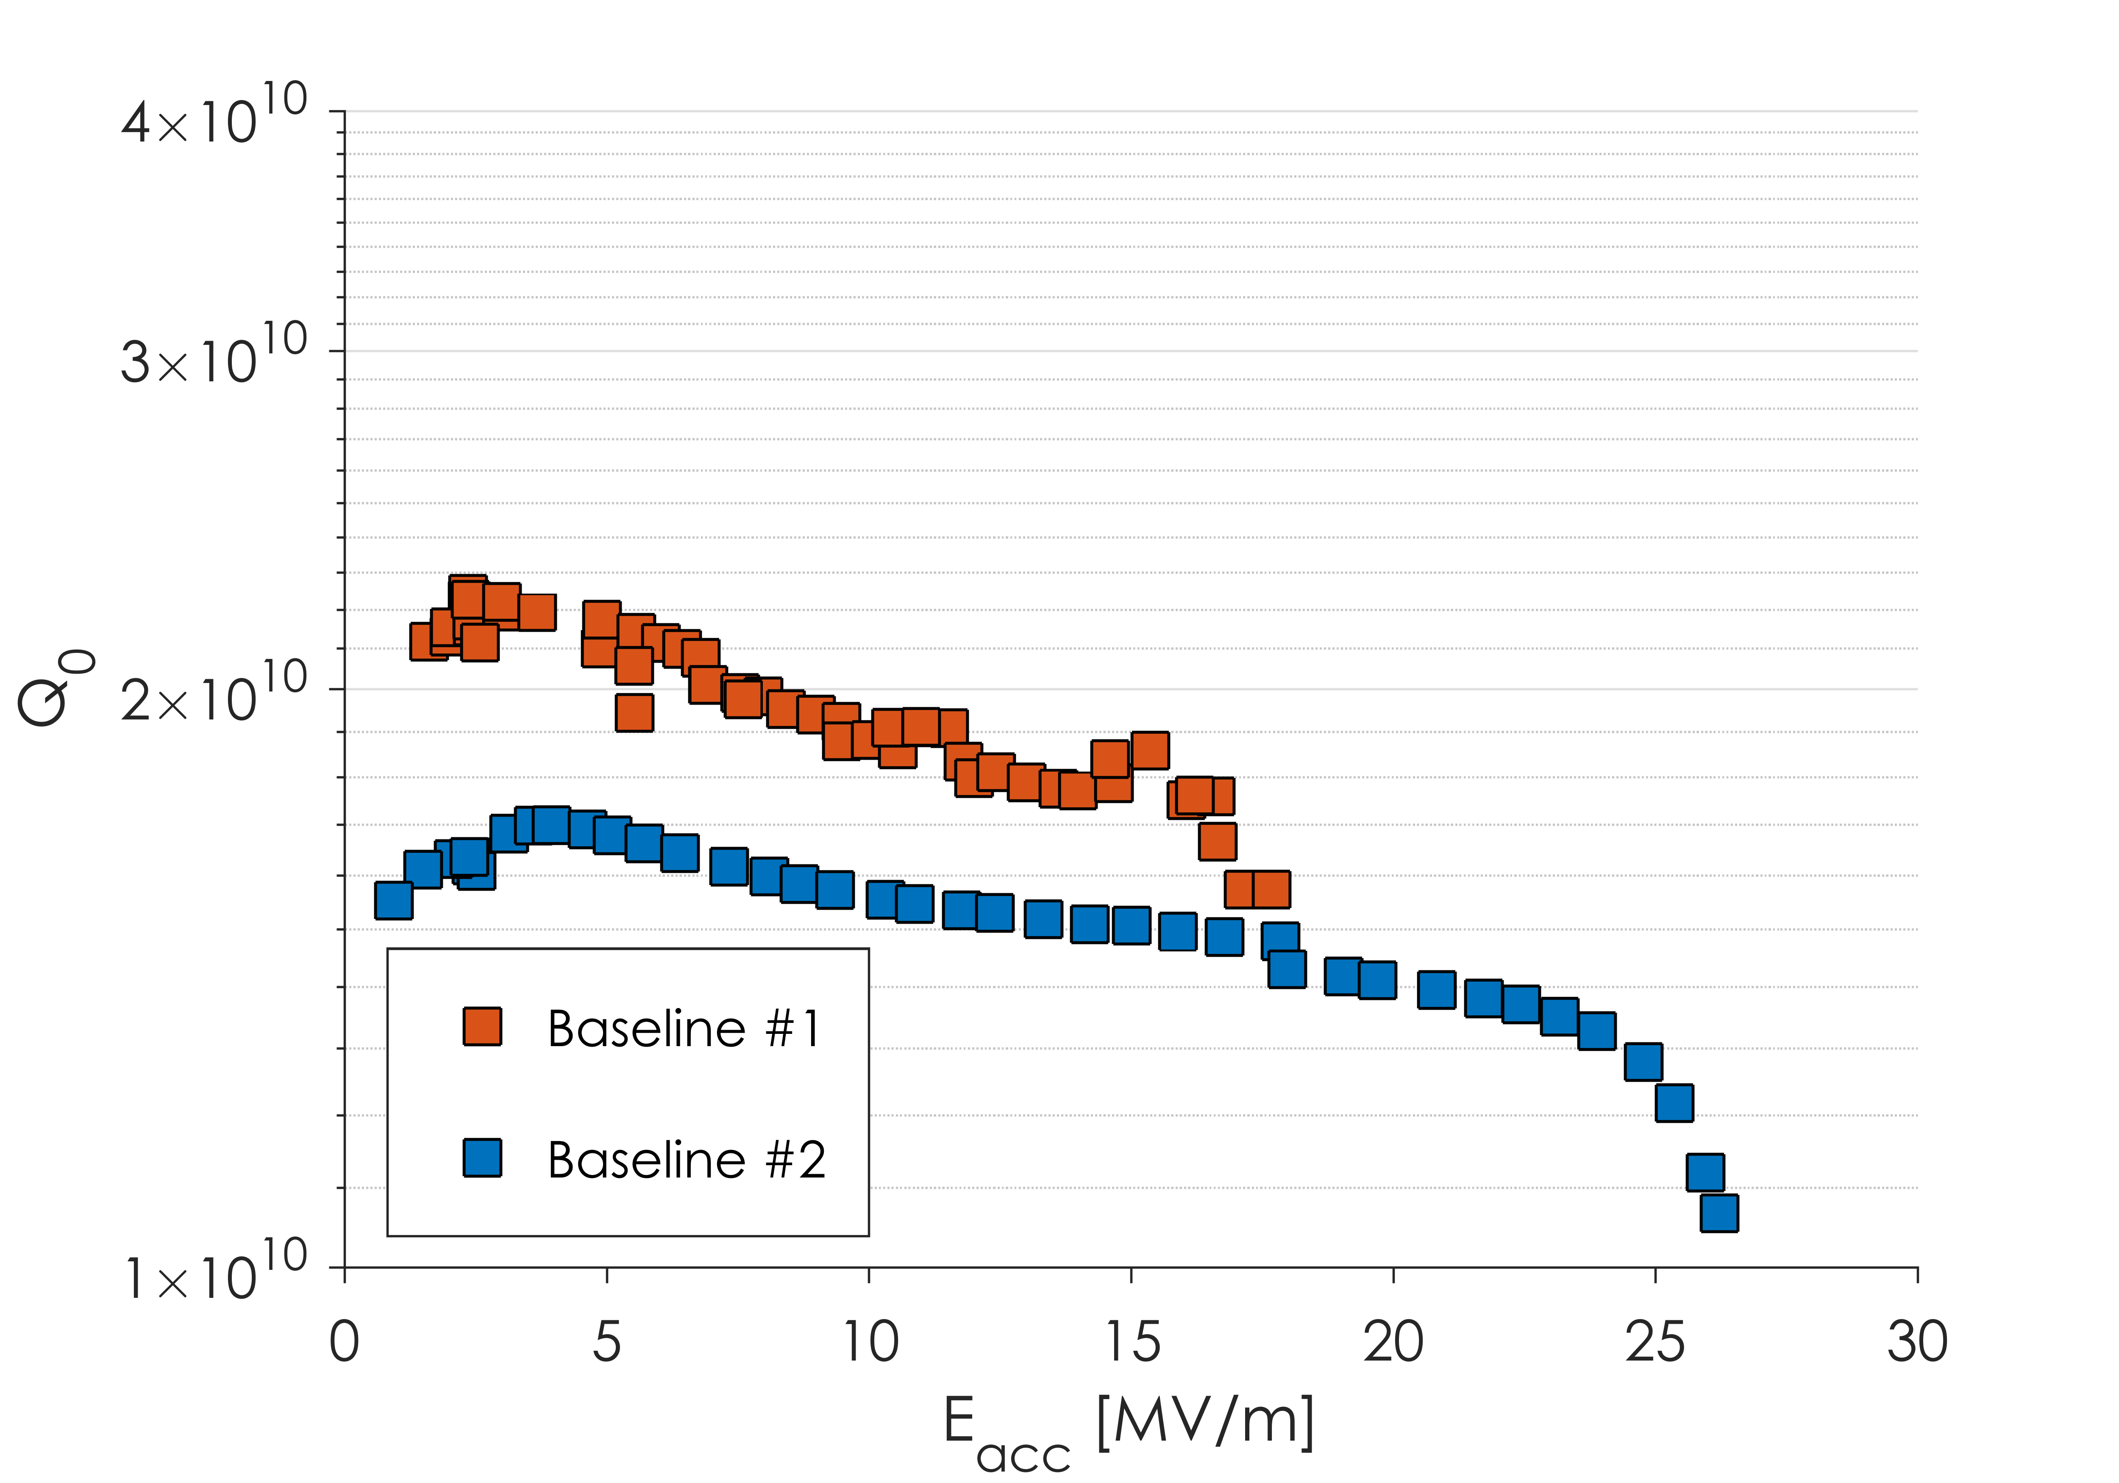
Nitrogen-Doping Introduction

Slide 9
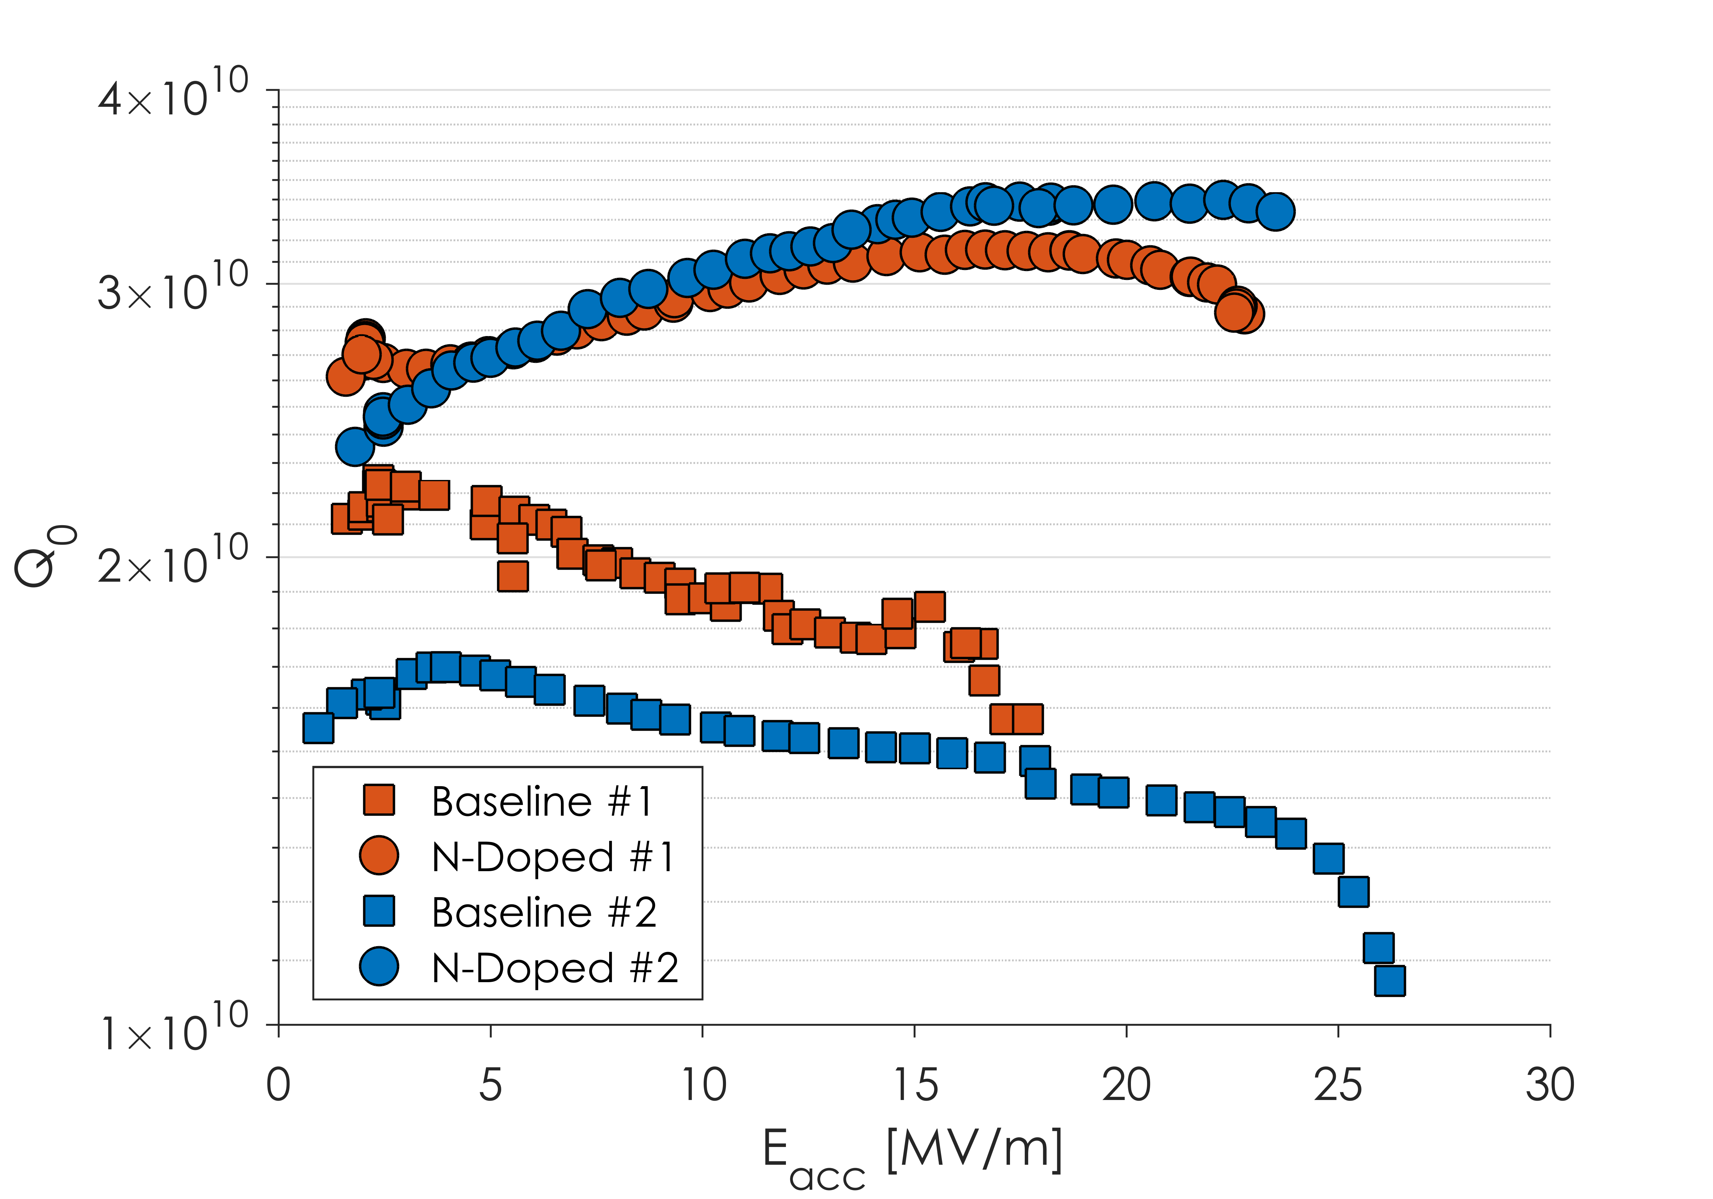
Nitrogen-Doping Introduction
Q is improved by 2 mechanisms:
Higher starting Q₀
Anti-Q slope
Both of these are a resulting of a changing R_{BCS}
Q₀’s of >3x10¹⁰ can consistently be produced

Slide 10
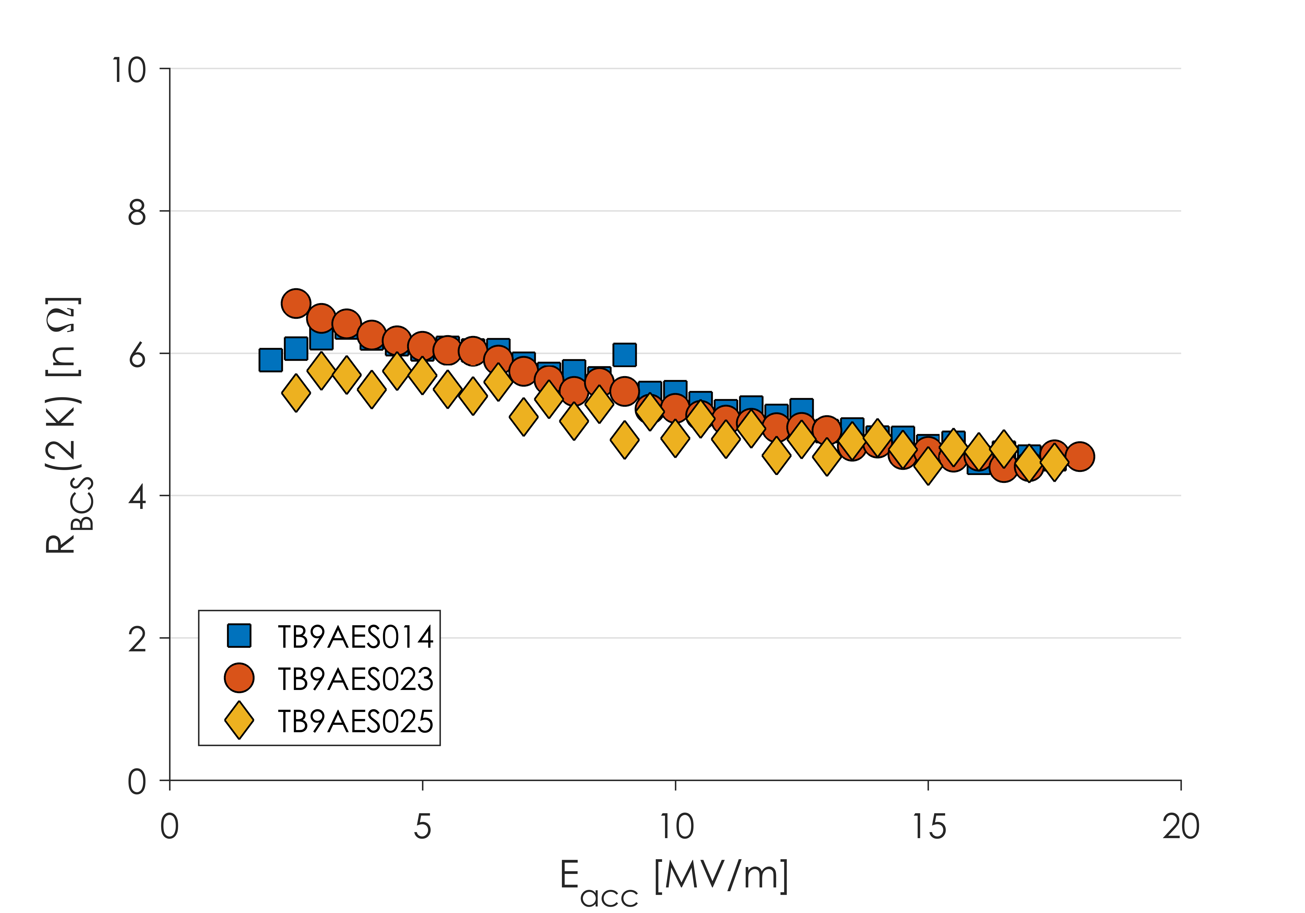
Anti-Q Slope
Anti-Q Slope caused by a decreasing R_{BCS}
Vendor Qualification Cavities

Slide 11
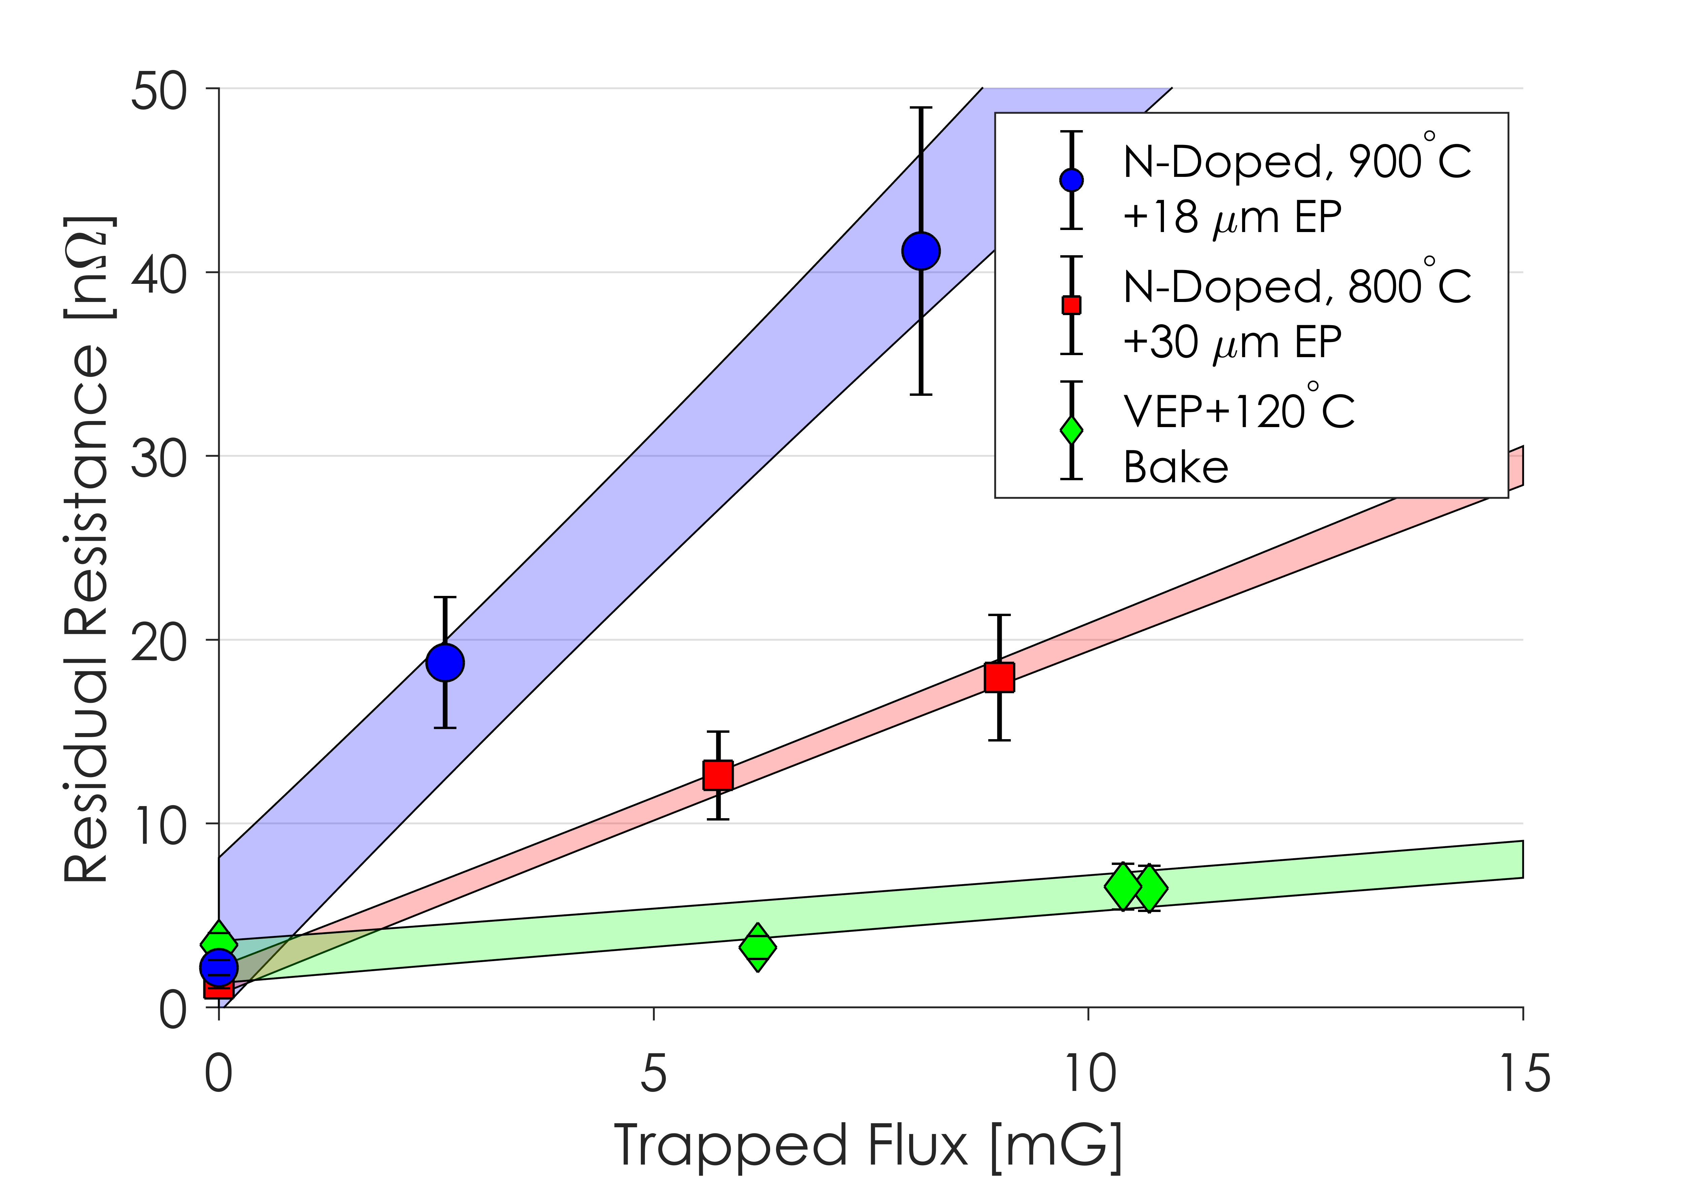
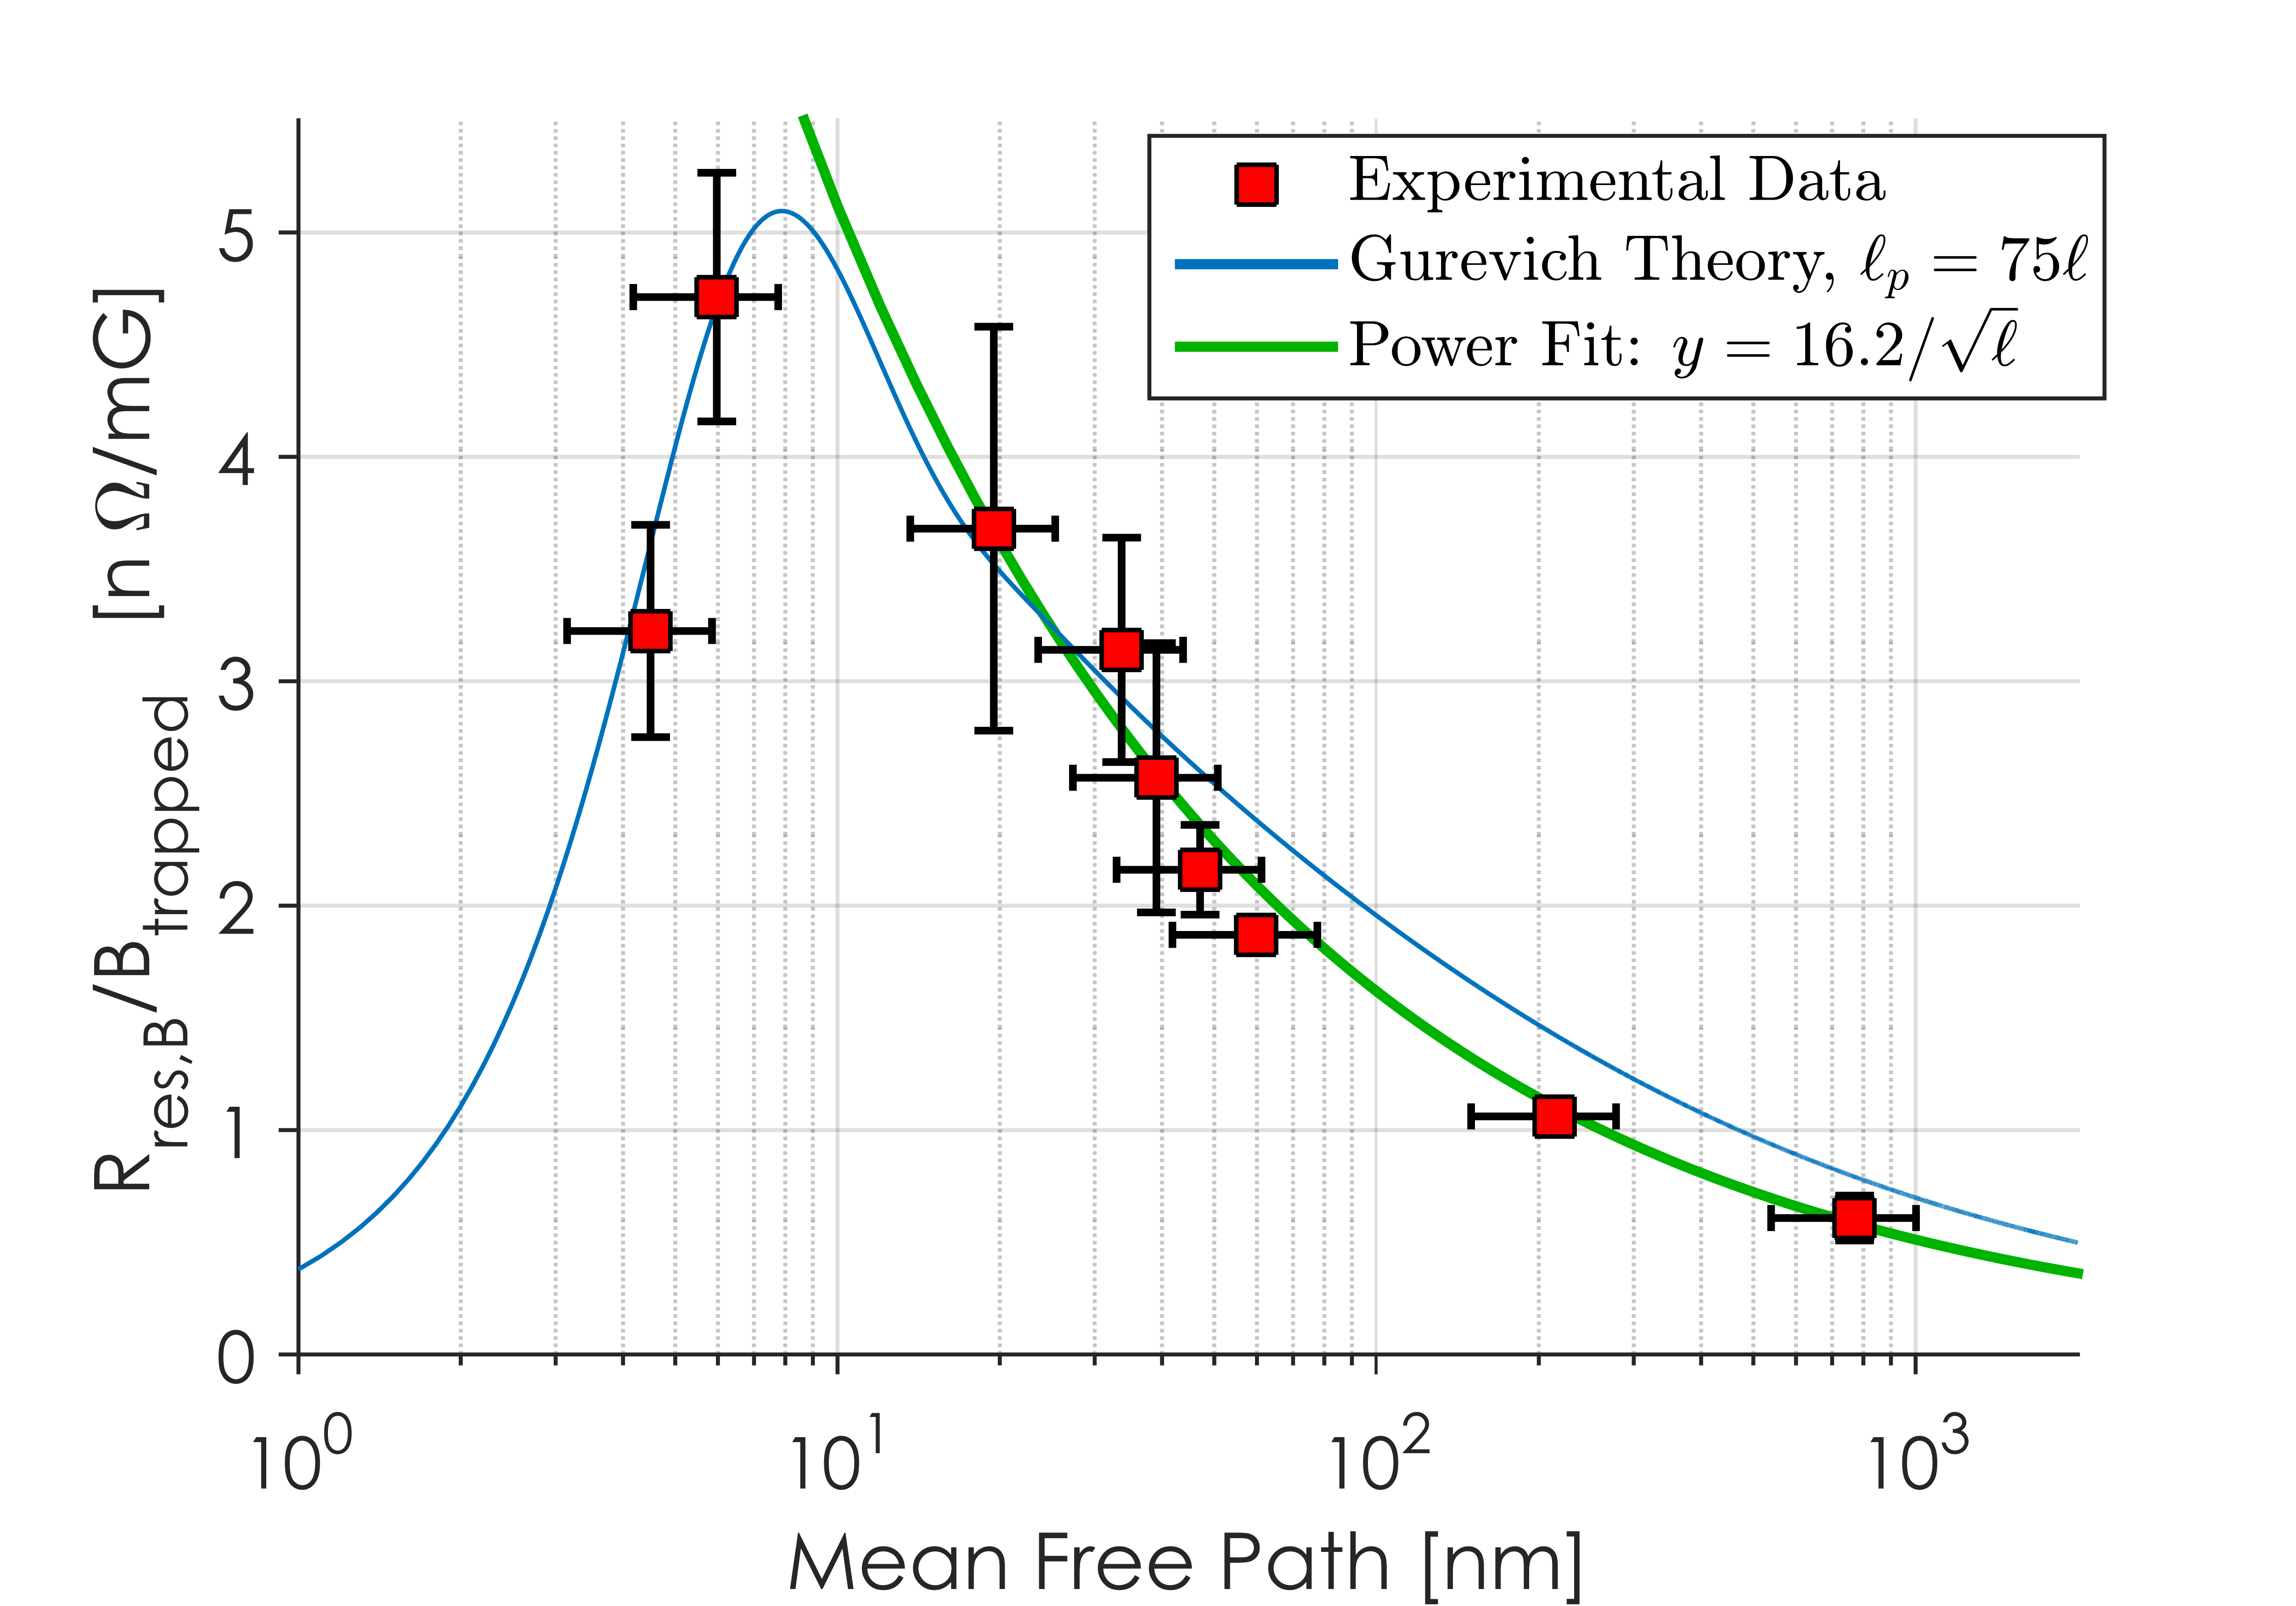
Drawbacks of N-Doping
Q₀ is significantly improved by the lowering of R_{BCS}
There is a tradeoff however with R_{res}
Nitrogen-doped cavities are more sensitive to losses from trapped magnetic flux
For the same amount of trapped flux, a N-doped cavity will have a higher R_{res} than an un-doped cavity
3.4x for the LCLS-II cavity recipe
This requires efficient flux expulsion or small ambient magnetic fields to maintain high Q₀
See Also:
A. Palczewski TUXBA06
S. Posen TUXBA02
J. Maniscalco TUYAA01
Presented at SRF 2015 and J. Appl. Phys. 119:073904

Slide 12
Outline
Overview of LCLS-II Cavity Requirements
First Article Results
Change of Recipe
R_{BCS} in Production Cavities
Production Results
Conclusions and Outlook

Slide 13
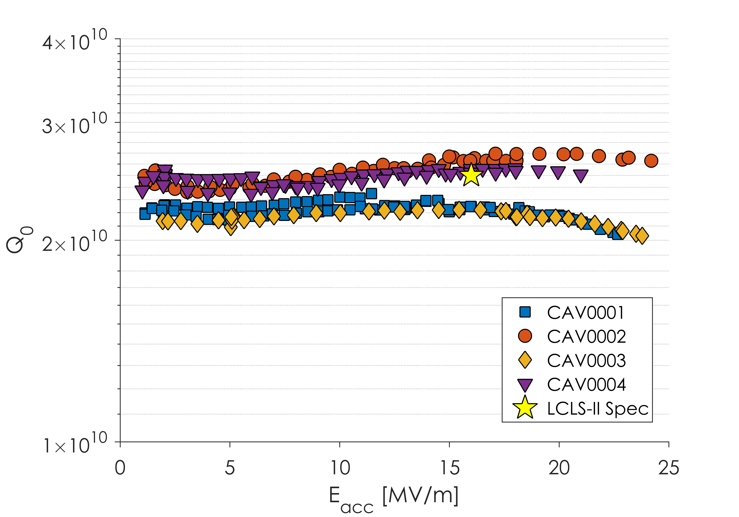
Q vs E for First Article Cavities
Some Great Cavities
Some Good Cavities
All these cavities tested in very low (0-1 mG) magnetic fields

Slide 14
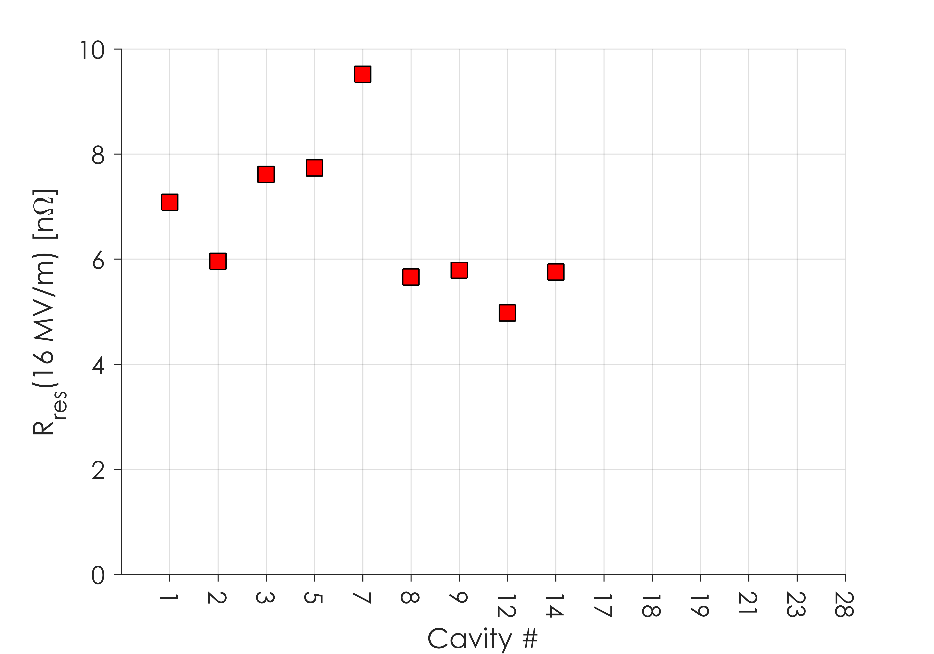
Residual Resistance in First Articles
R_{res} higher than in the prototyping phase
Expected 2-3 nΩ, found 5-9 nΩ
Spread is a result of differences in ambient magnetic fields

Slide 15
Issues with Original Recipe
Material from both vendors showed worse flux expulsion when treated at 800ºC in single-cell cavity tests than material used during the prototyping and R&D stage
All material meets specifications
This means that magnetic field specifications would need to be tighter in order to minimize the need for efficient flux expulsion
Cryomodule results thus far have shown ambient magnetic fields less than the LCLS-II CM Spec of 5 mG – further improvement on this would be difficult
140 μm bulk EP was insufficient to remove the damage layer, adding additional R_{res}
Worse flux expulsion is an independent phenomena from N-Doping – It impacts all cavity preparation methods

Slide 16
Outline
Overview of LCLS-II Cavity Requirements
First Article Results
Change of Recipe
R_{BCS} in Production Cavities
Production Results
Conclusions and Outlook

Slide 17
Cavity Preparation
In order to achieve the ambitious Q specification, all 9-cell cavities for LCLS-II are prepared with nitrogen-doping
Updated recipe:
200 μm bulk EP
900ºC degas for 3 hours in vacuum
2 minutes at 800ºC in 20-30 mTorr of N₂
6 minutes at 800ºC in vacuum
5-7 μm light EP
For additional information see:
A. Palczewski TUXBA06
S. Posen TUXBA02

Slide 18
Residual Resistance in First Articles

Slide 19
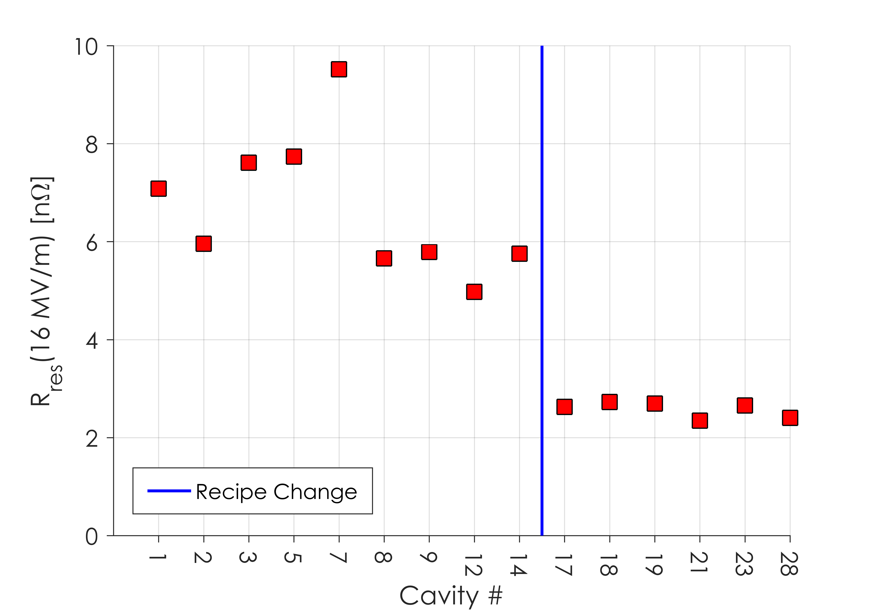
Residual Resistance After Recipe Change
Spread lower due to near 100% FE
After Increasing Bulk EP and Degas Temperature,
R_{res} is consistently ~2 nΩ

Slide 20
Q vs E for First Article Cavities

Slide 21
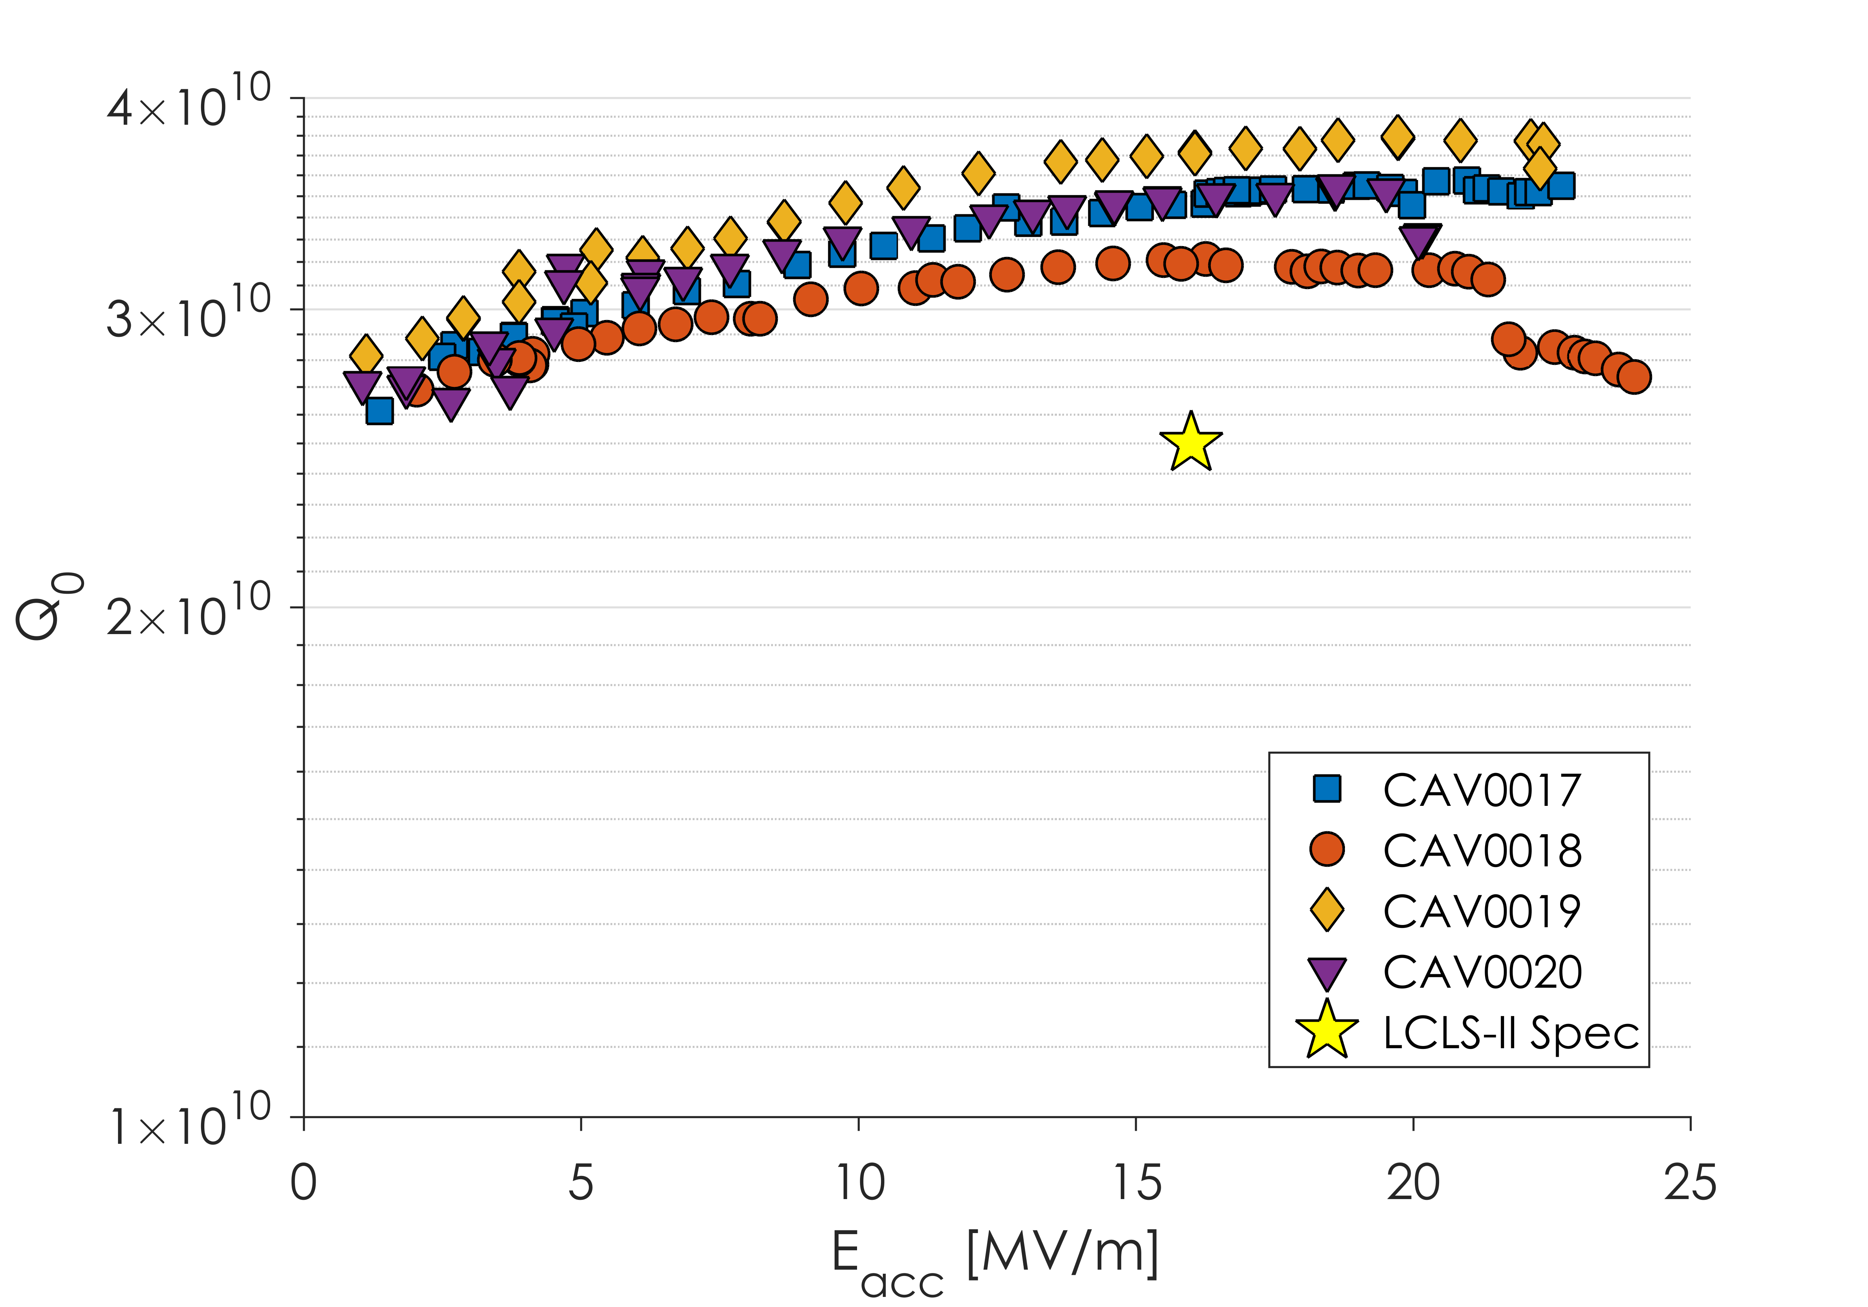
Q vs E for First Article Cavities
Highest Q₀ Ever Obtained in Production SRF Cavities
Cavities now consistently meet Q₀ specification

Slide 22
Outline
Overview of LCLS-II Cavity Requirements
First Article Results
Change of Recipe
R_{BCS} in Production Cavities
Production Results
Conclusions and Outlook

Slide 23
Reminder: Anti-Q Slope
Vendor Qualification Cavities

Slide 24
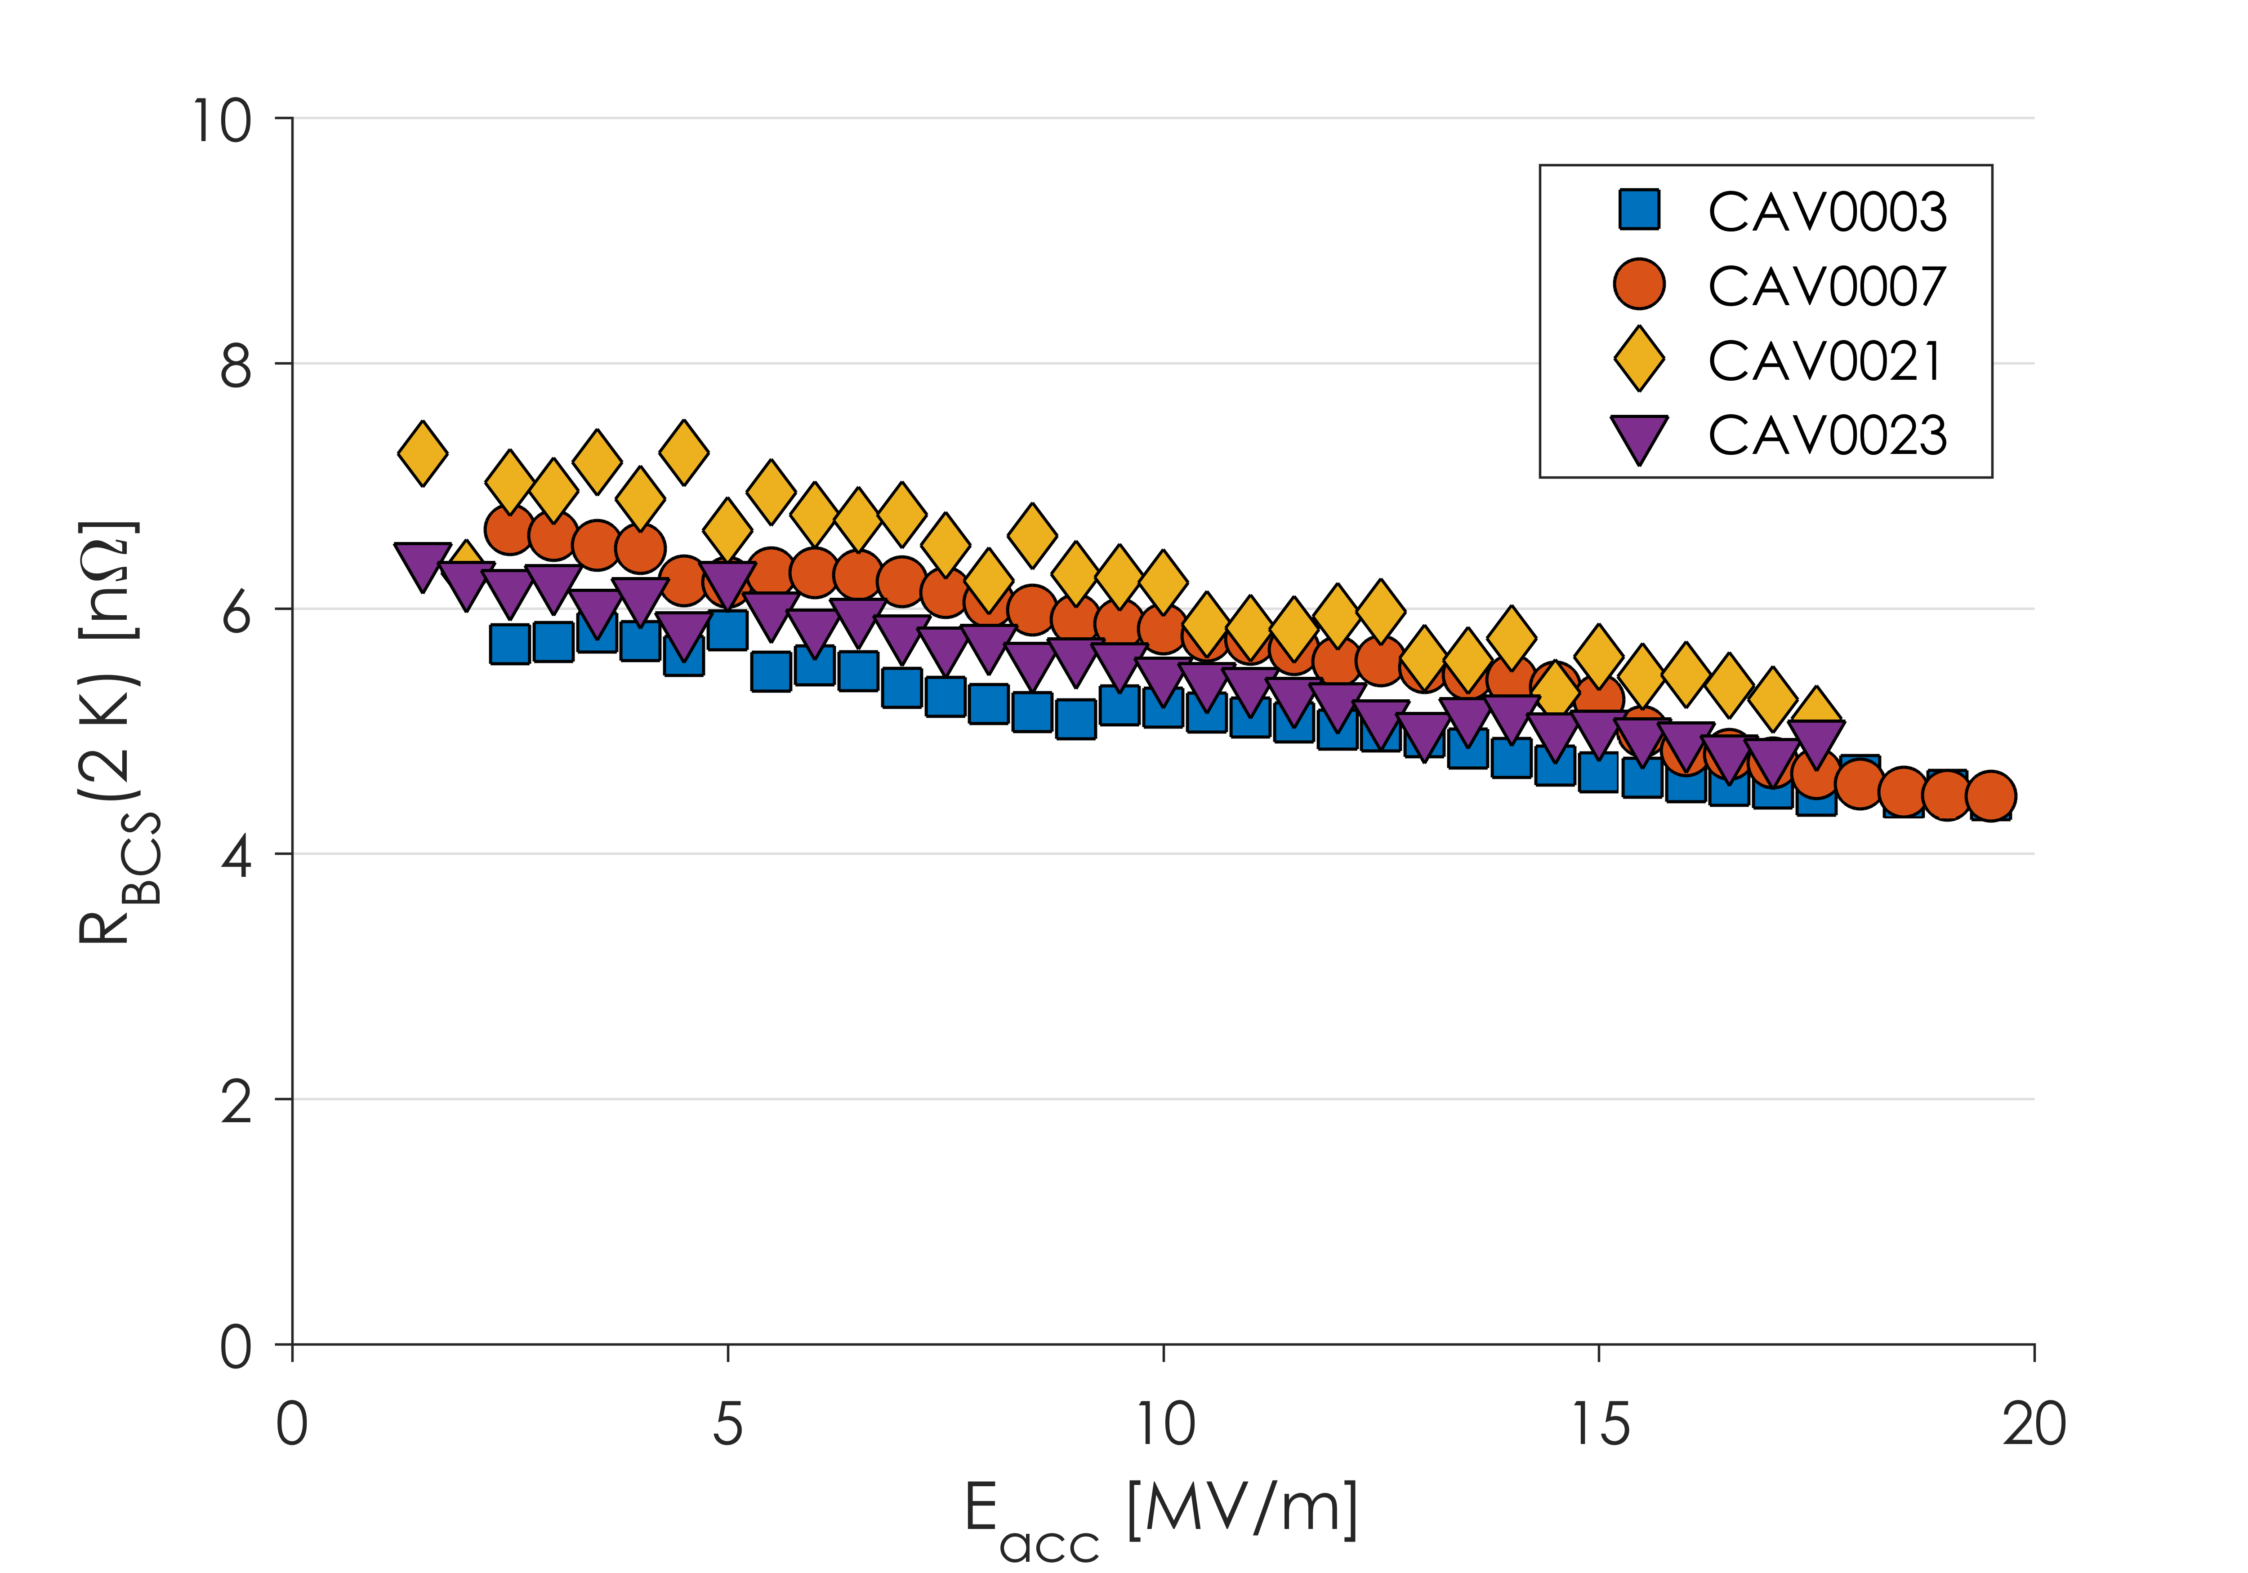
R_{BCS} in Production Cavities
Strong Anti-Q Slope
Decreasing R_{BCS} from ~7 to ~4 nΩ
Production cavities show similar anti-Q slope to R&D cavities

Slide 25
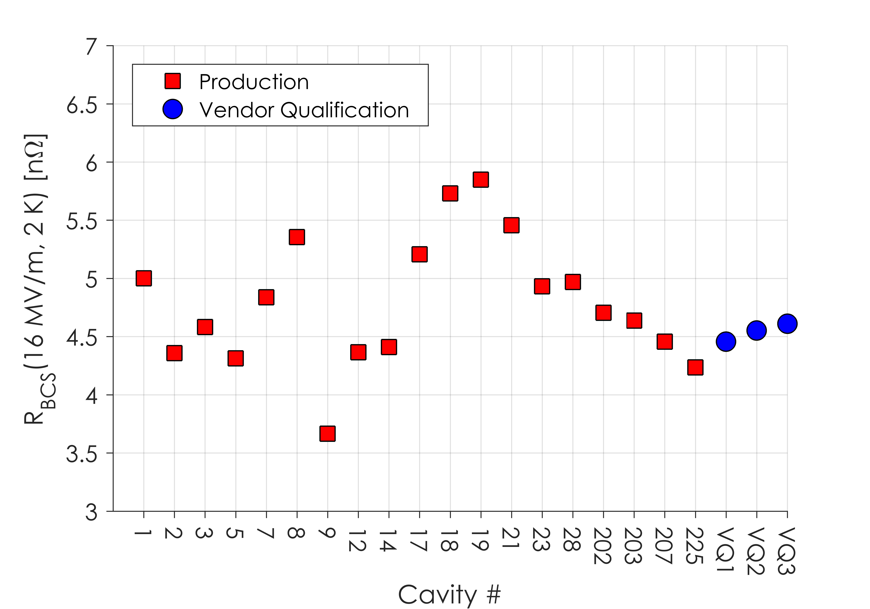
R_{BCS} in Production Cavities
R_{BCS} consistently between 4 and 6 nΩ at 16 MV/m
Mix of Material from 3 Vendors
R_{BCS} at 16 MV/m and 2.0 K is consistently 4-6 nΩ
This is consistent with “2/6” N-Doping developed in the R&D phase of LCLS-II

Slide 26
Outline
Overview of LCLS-II Cavity Requirements
First Article Results
Change of Recipe
R_{BCS} in Production Cavities
Production Results
Conclusions and Outlook

Slide 27
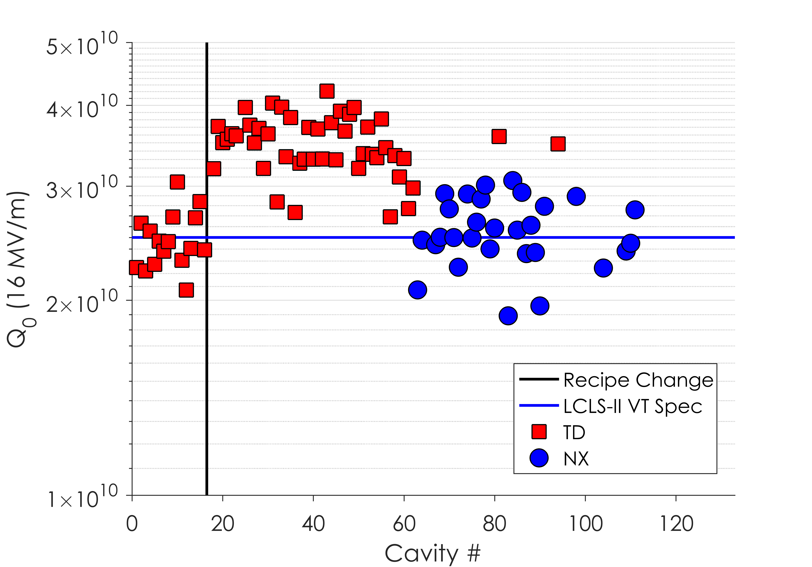
Vendor B Results
Vendor B has completed fabrication of original order of 133 cavities
99 cavities have been tested so far at JLab and Fermilab

Slide 28
Vendor B Results
Vendor B has completed fabrication of original order of 133 cavities
99 cavities have been tested so far at JLab and Fermilab
TD Cavities 900/200 preparation consistently exceed LCLS-II spec

Slide 29
Vendor B Results
Vendor B has completed fabrication of original order of 133 cavities
99 cavities have been tested so far at JLab and Fermilab
TD Cavities 900/200 preparation consistently exceed LCLS-II spec
NX Cavities have middling results with Q₀’s ranging from 2 to 3x10¹⁰
Future NX cavities will be treated at 950ºC – evidence suggests this improves Q_{o}

Slide 30
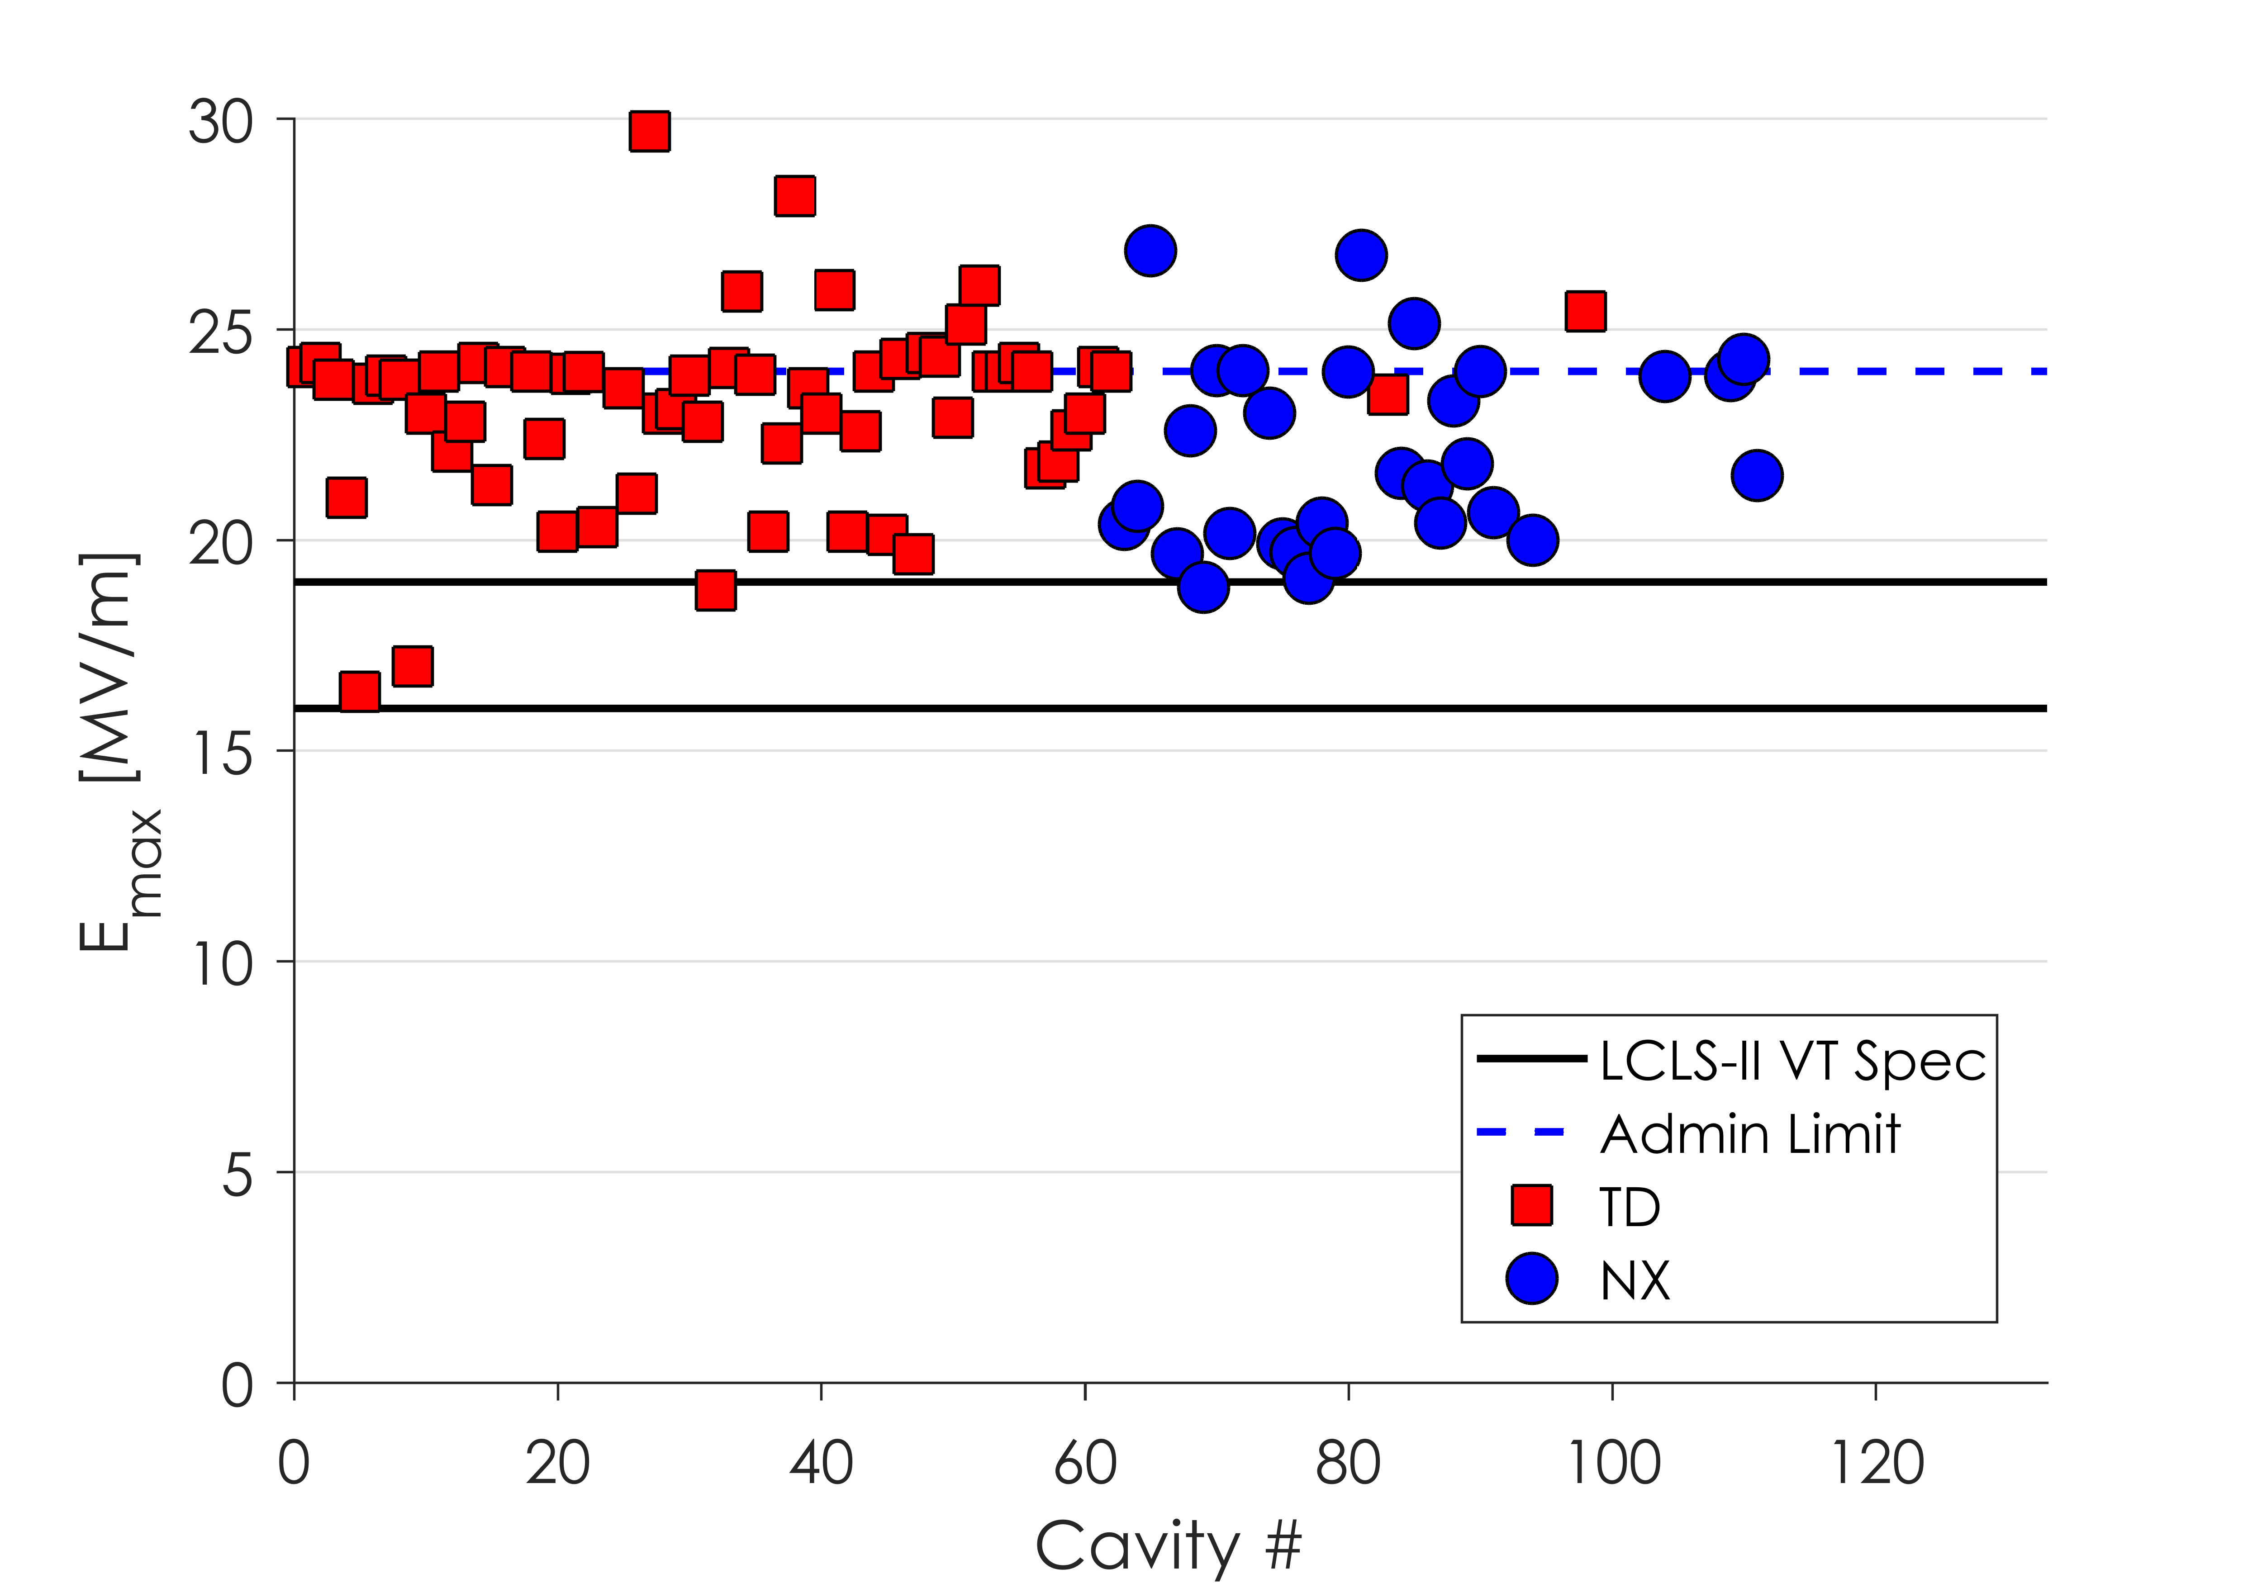
Vendor B Results
JLab employs an administrative limit at 24 MV/m during VT
Gradient reach has consistently exceeded specification throughout production

Slide 31
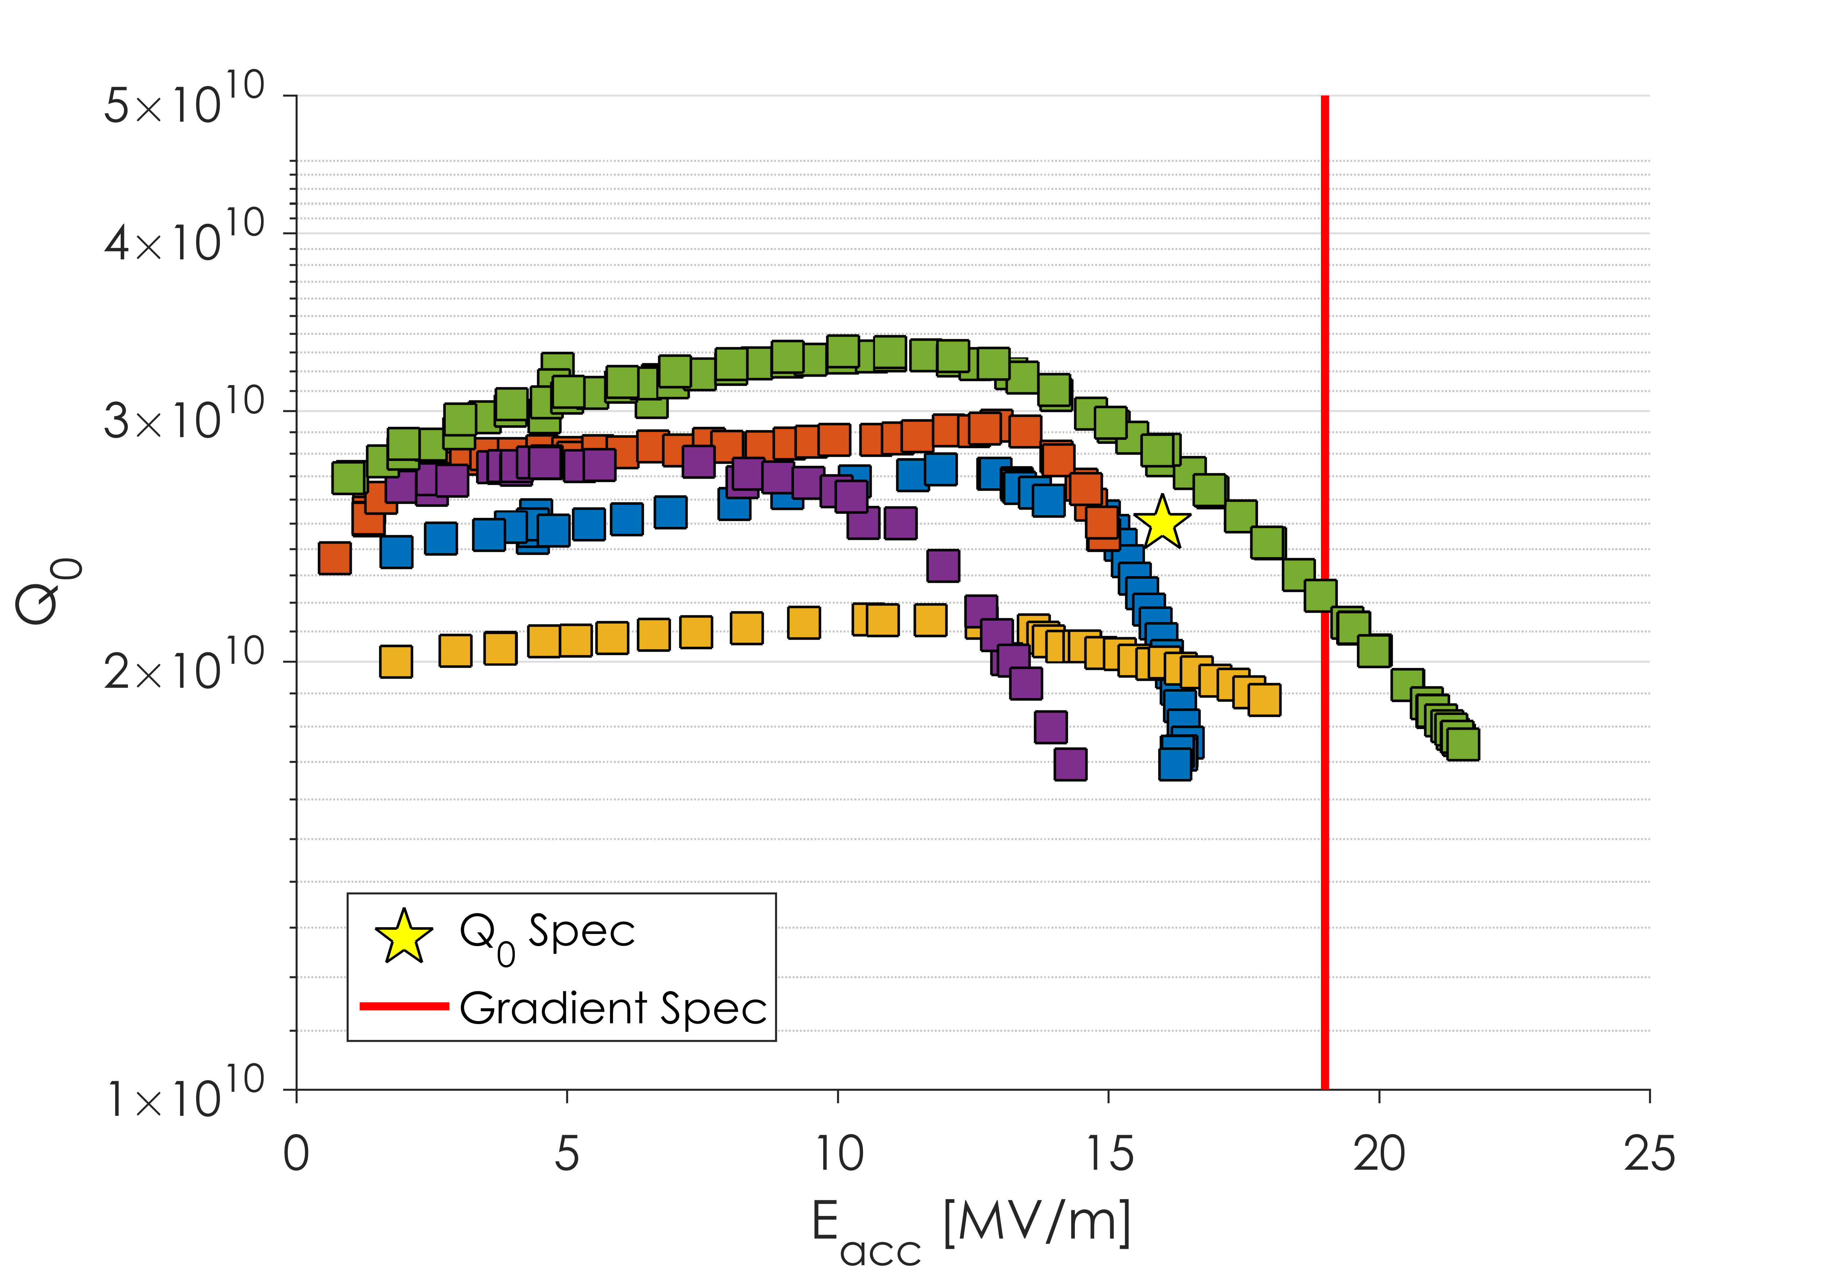
Vendor A Results
Q Slope Onset 12-14 MV/m
Vendor A cavities were dominated by a strong Q slope with onset 12-16 MV/m
This Q slope led to early quench and low Q at 16 MV/m
Subset of cavities, behavior observed in most

Slide 32
Vendor A – Surface Roughness
This Issue was Fixed
Data from Y. Trenikhina
EP at Vendor A was producing a very rough surface
Roughness was as high as 15 μm
It was found that EP temperature was leading to the EP no longer being in the “polishing regime” but in the “etching regime”

Slide 33
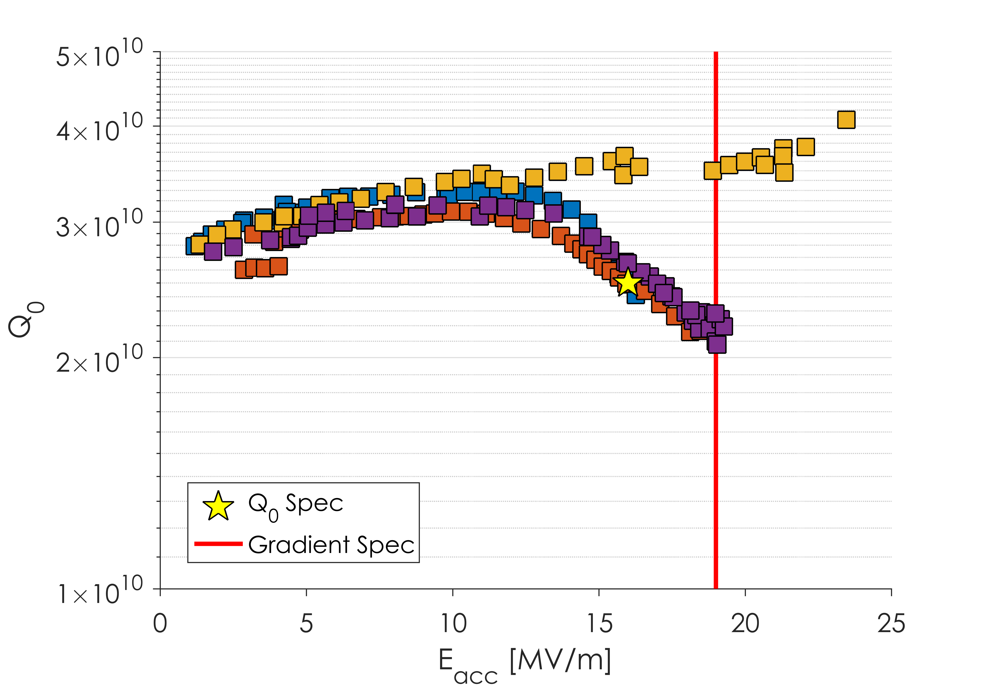
Vendor A – Surface Roughness
Q Slope Still Present after EP Procedure Change
3 of 4 cavities with “New EP” still had strong Q slope
Bad EP was not the cause of the performance issues

Slide 34
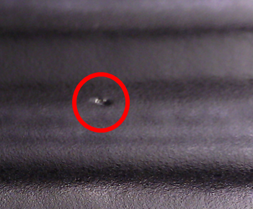
Vendor A – Grinding Technique
Visual inspection of the interior of Vendor A cavities after fabrication showed the presence of many defects
Some pits had visible normal conducting media embedded
Theorized that aggressive grinding on the dumbbell surface led to the “burying” of media
This normal conducting media would then be revealed after bulk EP
All procedures were reworked with LCLS-II staff to improve the fabrication procedures

Slide 35
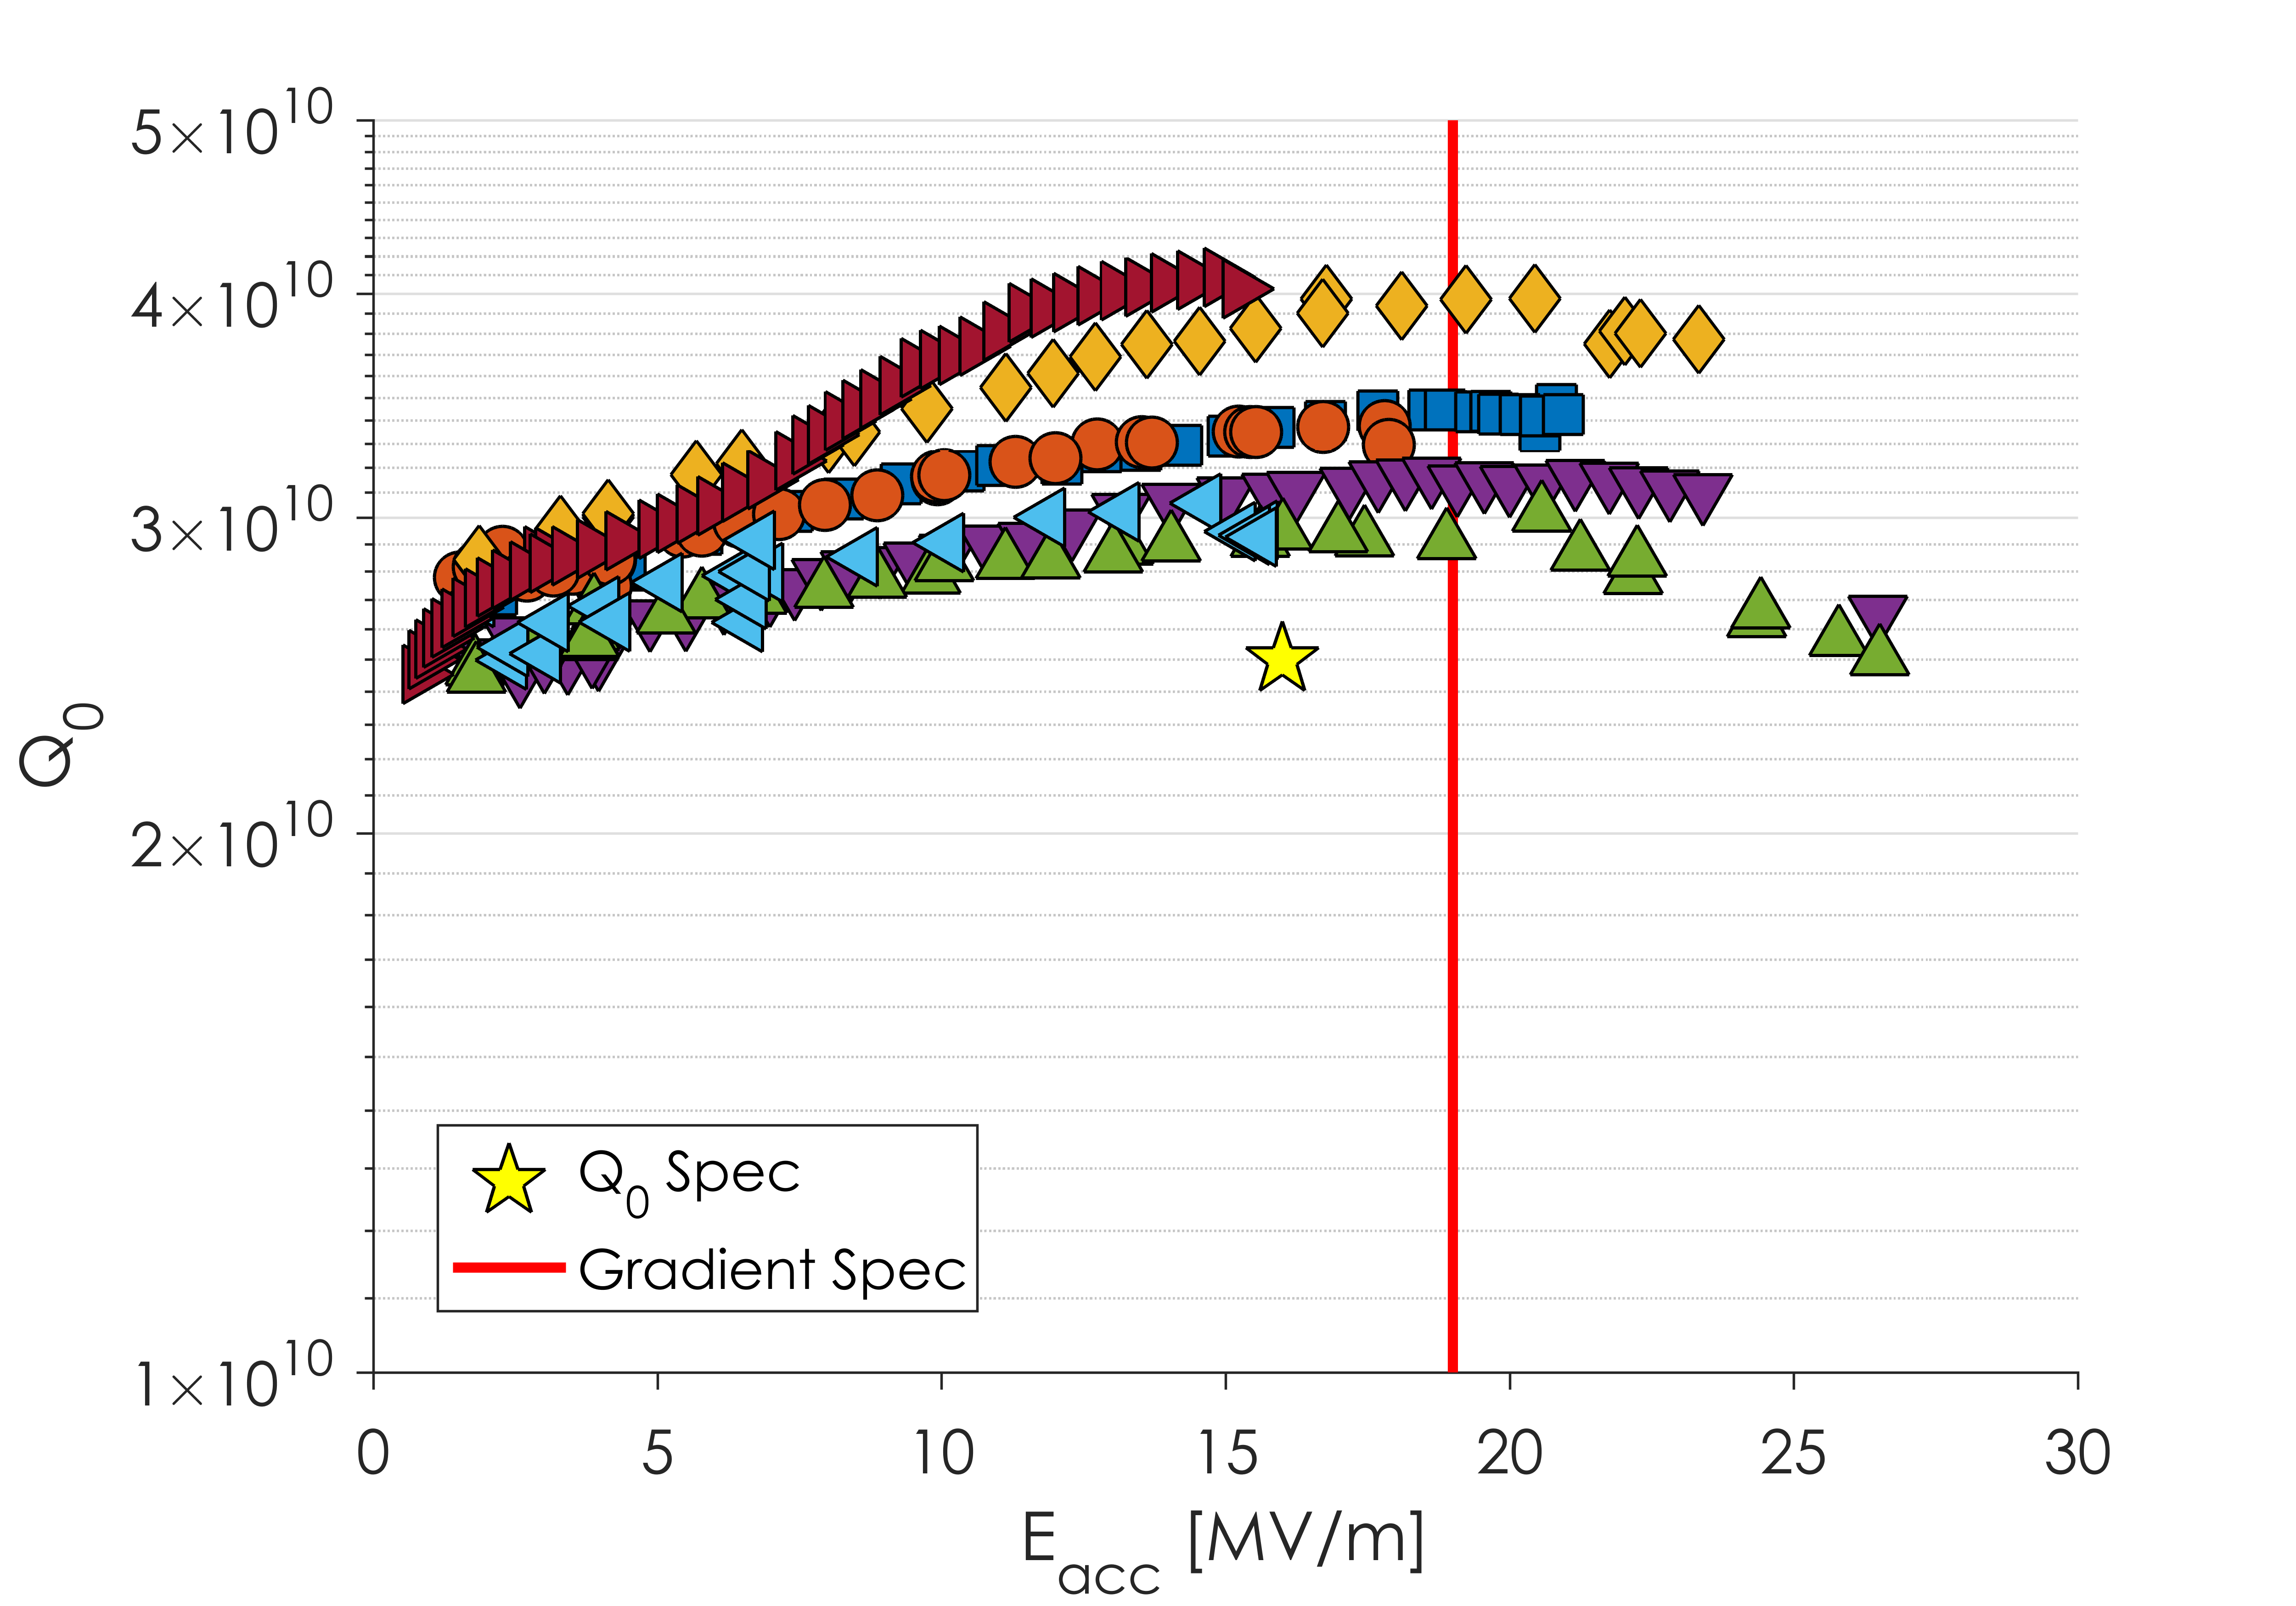
Vendor A – Restart
7 cavities have been tested so far after restart
No evidence of Q slope that was seen before
2 of the 7 still have lower than ideal quench fields – may be related to expected spread

Slide 36
Outline
Overview of LCLS-II Cavity Requirements
First Article Results
Change of Recipe
R_{BCS} in Production Cavities
Production Results
Conclusions and Outlook

Slide 37
Conclusions and Outlook
Production of cavities for LCLS-II is well underway
The original recipe used caused poor flux expulsion and higher residual resistance than expected leading to a recipe change
With the new recipe TD cavities routinely reach >3x10¹⁰ at 16 MV/m
NX cavities still produce middling results: all future NX cavities will be heat treated at higher temperature

Slide 38
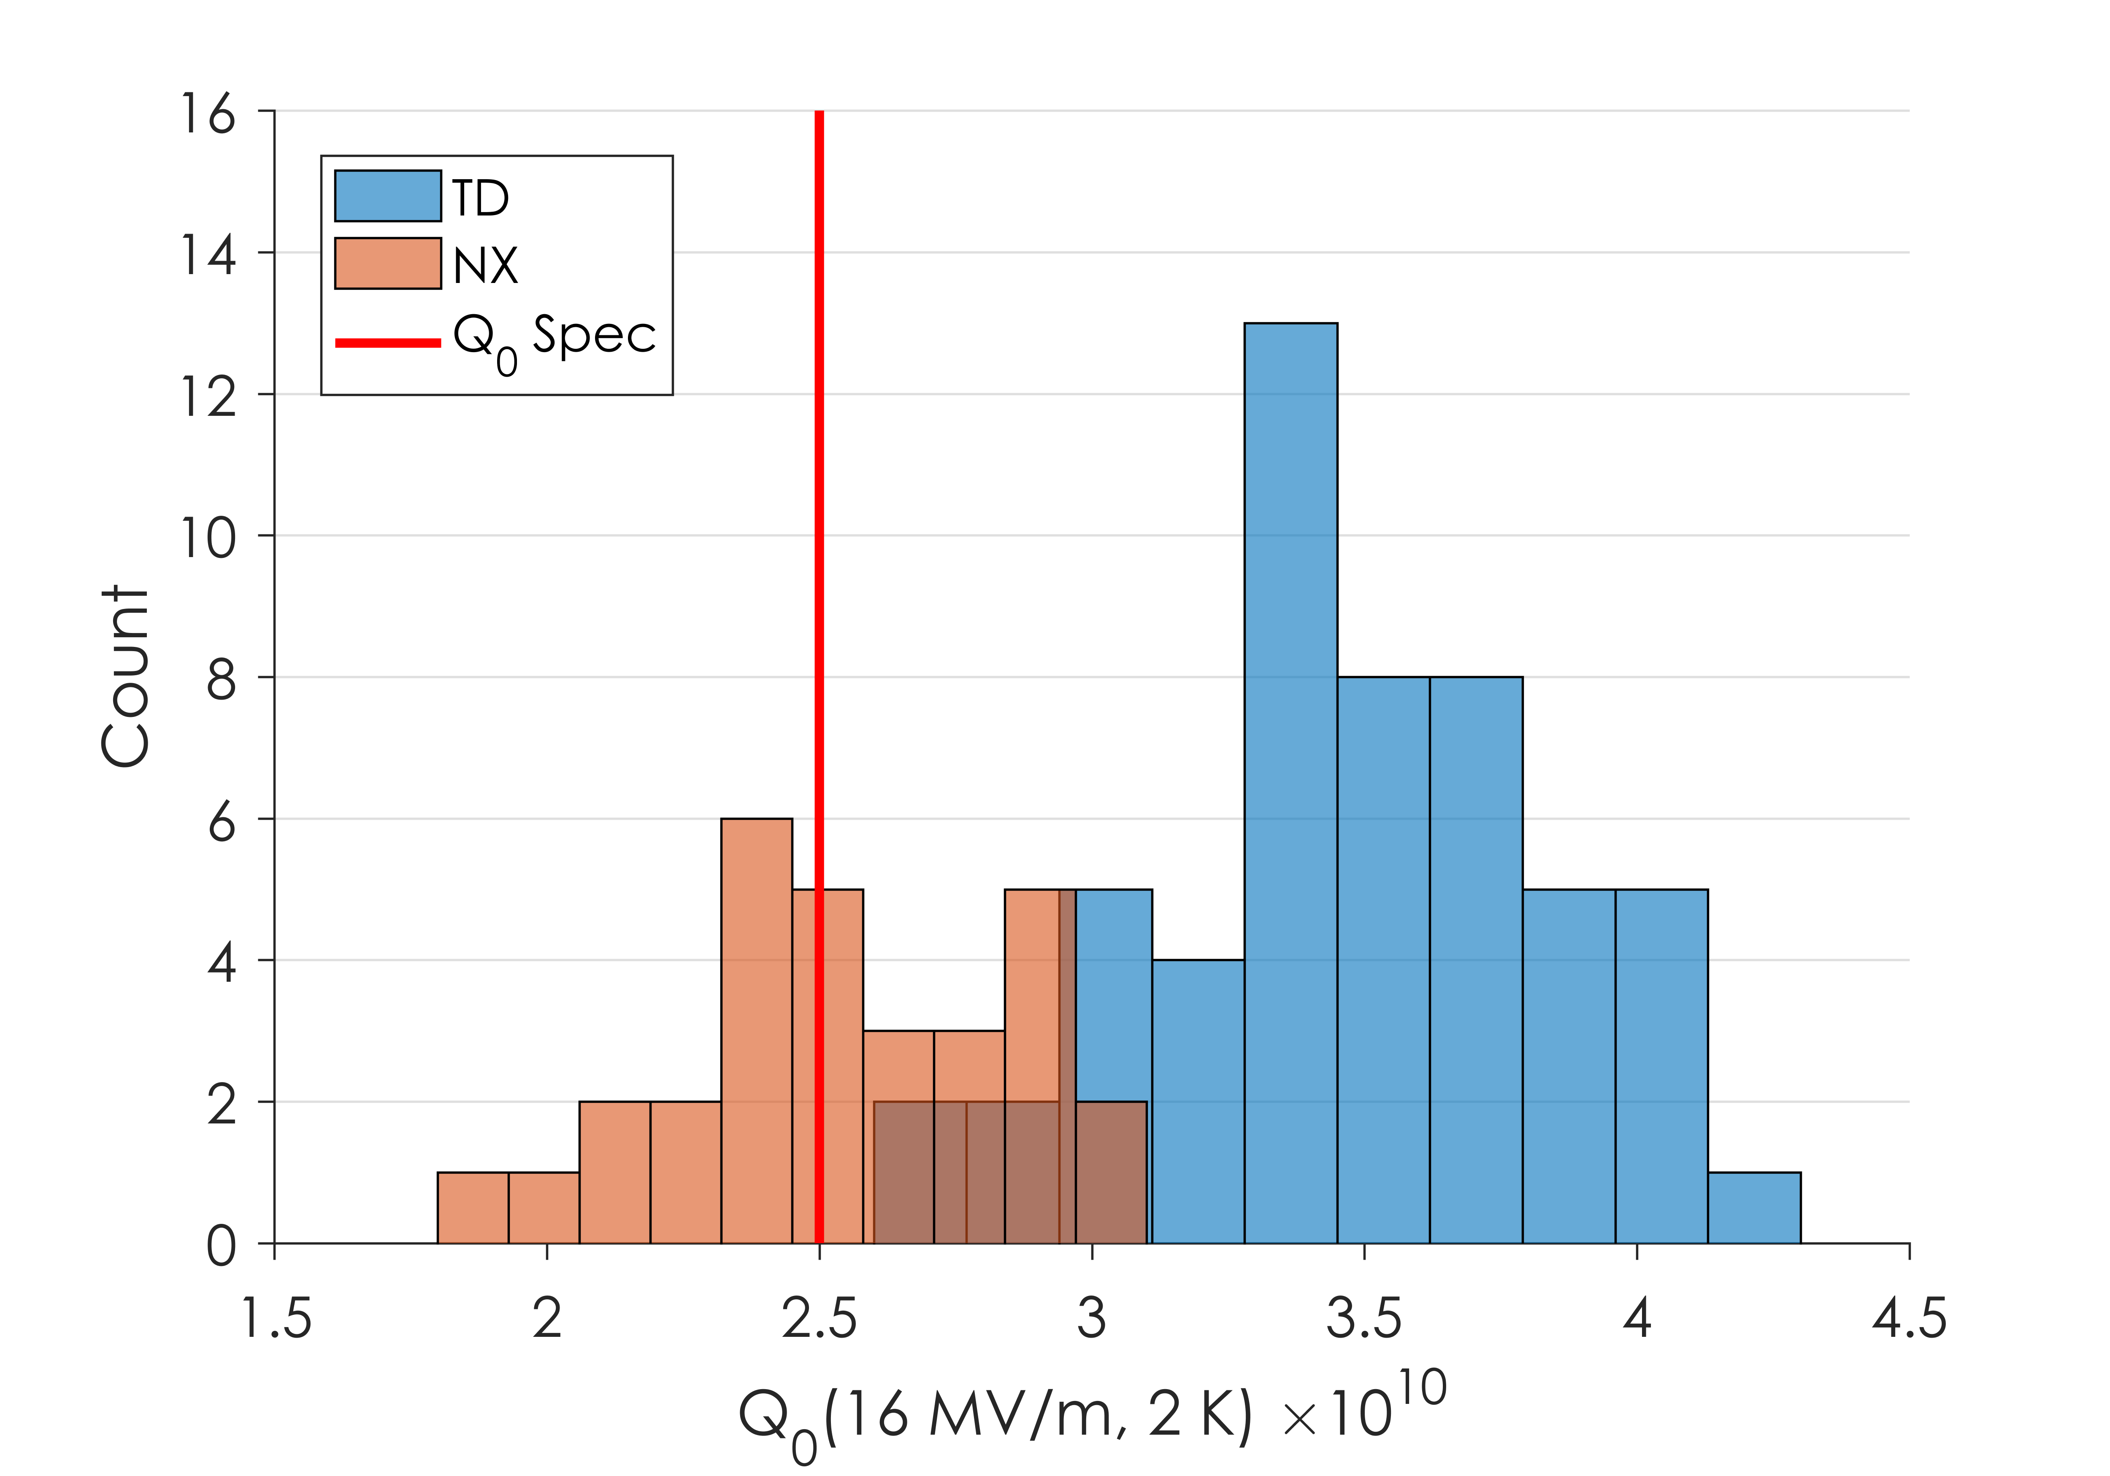
Conclusions and Outlook
Q₀ at 16 MV/m
Production of cavities for LCLS-II is well underway
The original recipe used caused poor flux expulsion and higher residual resistance than expected leading to a recipe change
With the new recipe TD cavities routinely reach >3x10¹⁰ at 16 MV/m
NX cavities still produce middling results: all future NX cavities will be heat treated at higher temperature

Slide 39
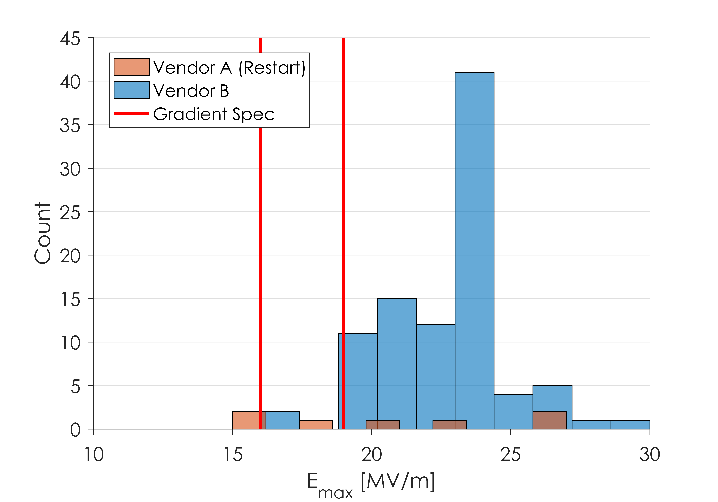
Conclusions and Outlook
Maximum Gradient
Production of cavities for LCLS-II is well underway
The original recipe used caused poor flux expulsion and higher residual resistance than expected leading to a recipe change
With the new recipe TD cavities routinely reach >3x10¹⁰ at 16 MV/m
NX cavities still produce middling results: all future NX cavities will be heat treated at higher temperature
Vendor B consistently produces cavities with great Q₀ and quench fields
Vendor A has had issues with improper EP parameters, and a grinding technique that led to a strong Q slope
LCLS-II staff oversight and rework at Vendor A has improved performance – Vendor A now produces good cavities

Slide 40
Lessons Learned So Far
When dealing with high Q₀ great care needs to be taken to maintain performance
Flux expulsion is especially important in Nitrogen-Doped cavities
Changes to cavity preparation recipe has been necessary at multiple stages to ensure performance is kept high
In order to meet schedule demands, some cavities will have worse flux expulsion than others
Retreating all cavities is not a feasible option
Project oversight at cavity vendors is important
However when great care is taken…
We Can Obtain World Record Q₀ in Production

Slide 41
Questions?

